Slide 1
Is mechanical compression suitable for atmospheric CO2 utilisation on Mars?
Sam Ross

Slide 2
Context and State-of-the-Art
Pre-term and Week M1

Slide 3
Motivation
Returning rockets to Earth requires large masses of propellant
Fundamentals of rocket equation demand extreme masses to Earth orbit
Gear ratio (m_{earth orbit}/m_{surface of Mars}) is 3-4
Manufacturing propellant in-situ has the potential for mass leverage
One tonne of chemical plant can produce many tonnes of propellant
All current designs for Martian propellant manufacture utilise atmospheric carbon dioxide as chemical feedstock
Atmospheric density is very low, unsuitable for practical use
Compression is required

Slide 4
Martian compression - current state of the art
Some historical work from NASA + contractors
Relatively small quantities/flows required
Emphasis on proving performance at subscale
Historically, mechanical systems rejected
High mass, power, complexity
Cryocooler/freezer-pump systems preferred
Few recent developments
MOXIE uses single-stage scroll compressor

Slide 5
Current state of the art…

Slide 6
…is far from what’s required

Slide 7
…is far from what’s required
NASA reference architecture (DRA5)
SpaceX refuelling requirement

Slide 8
Perceived issues with mechanical compression
High power
Sensitive to dust
Heavy

Slide 9
Perceived issues with mechanical compression
High power
Comparison to roughing pumps (piston) usually made
Testbed scales – mechanical does perform badly!
Current state of art isn’t especially low power either
Sensitive to dust
Heavy

Slide 10
Ts diagram generation
Week M1 + M2

Slide 11
Approach
CoolProp Python interface
Good at evaluating properties above triple point
Reduced functionality below this point
Phase must be forced to be gas
Cannot do arbitrary property -> property evaluations
Evaluation near sublimation line: compare to literature
Vukalovich and Altunin, Thermophysical Properties of Carbon Dioxide
Enthalpy, entropy, density on sublimation line
No equations of state for sub-triple behaviour

Slide 12
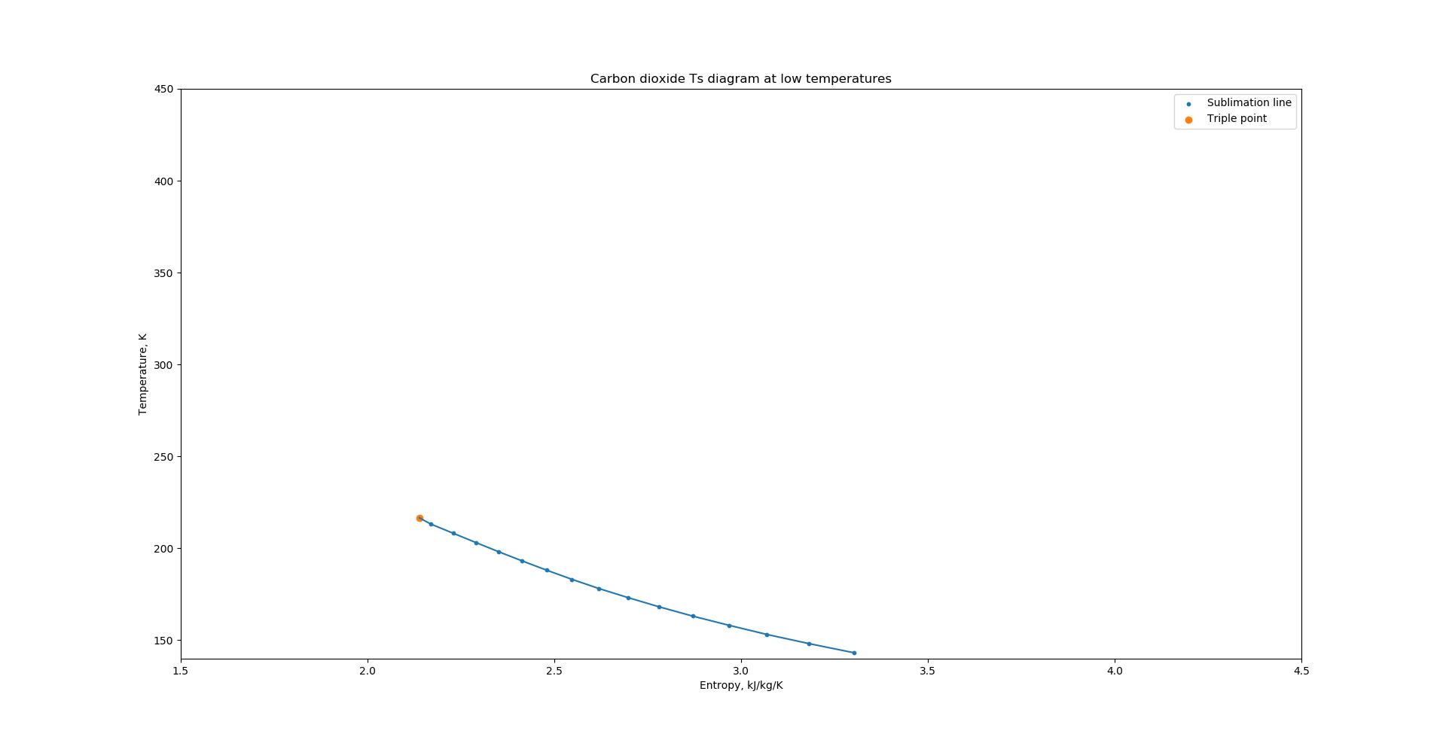
Sublimation line

Slide 13
Methods for building Ts diagram
Direct evaluation on gridlines
Evaluate h(T,s) and p(T,s)
Effective and quick to evaluate
Limited range
Above triple point temperature only
Reverse evaluation, interpolation
Evaluate s(T, p) and h(T, p)
Invert and interpolate p(s) and h(s) at each value of T
Slow, breaks down below sublimation line
Can produce a value across entire range
Not always physical

Slide 14
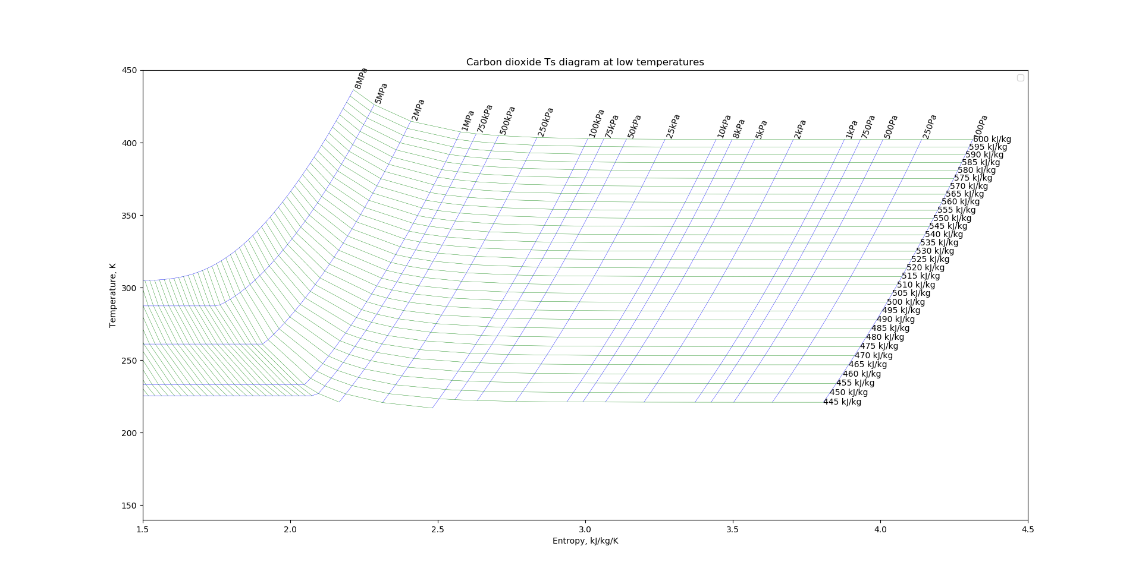
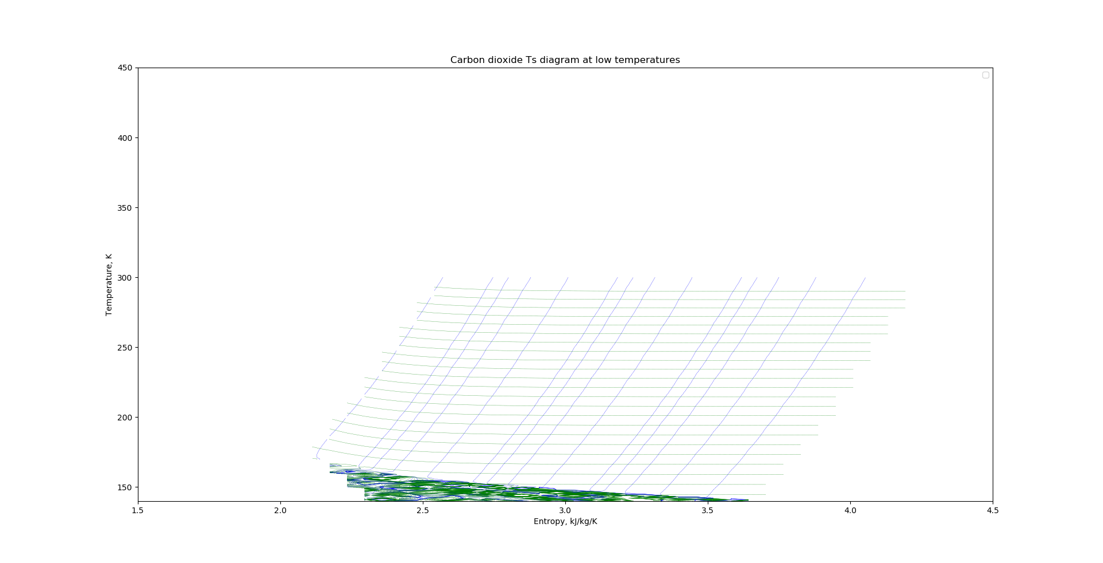
Output of each method
Direct evaluation
Reverse evaluation and interpolation

Slide 15
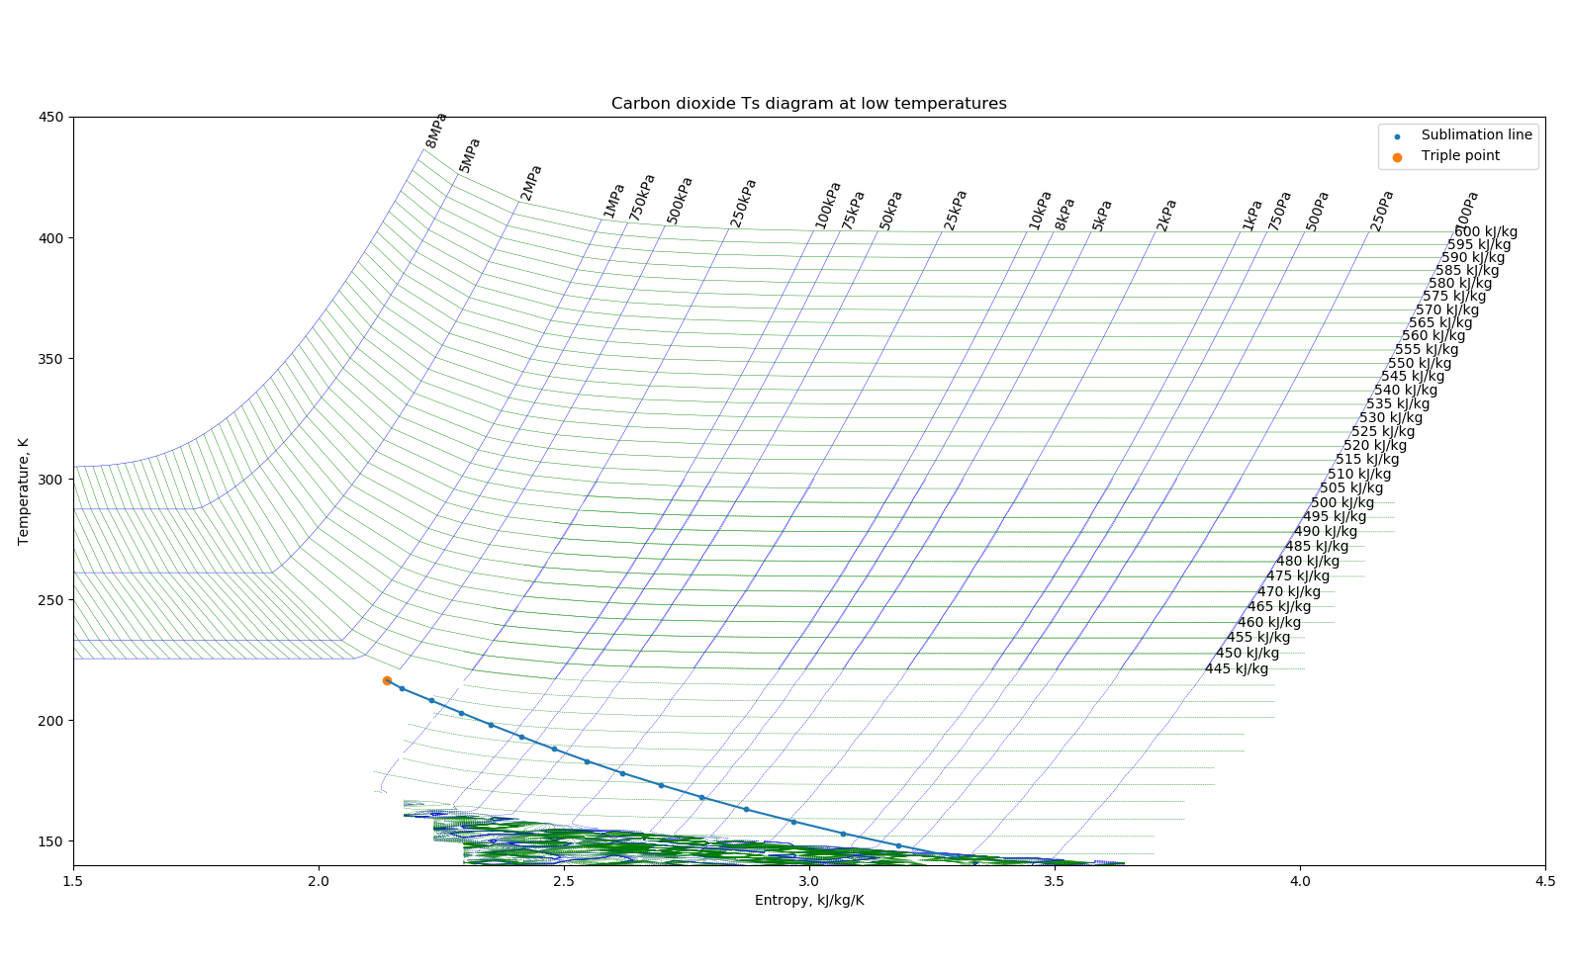
Combined output

Slide 16
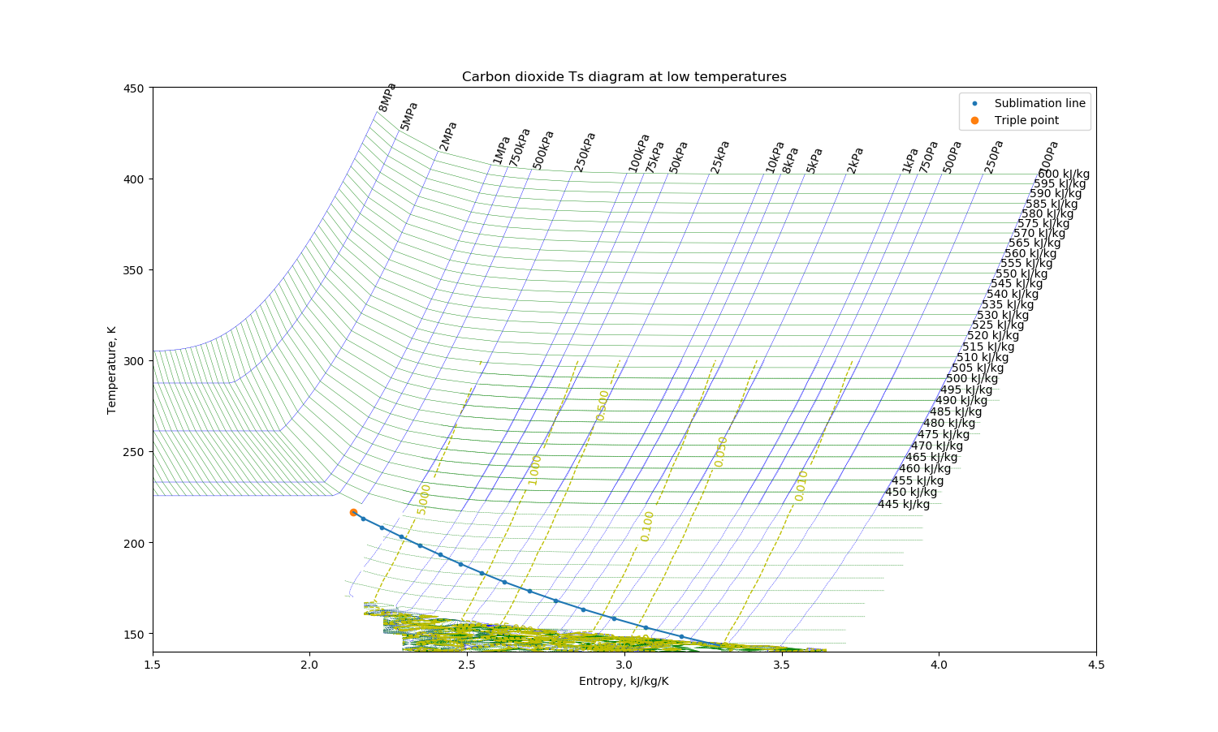
Operating envelope
Weather
Night

Slide 17
Combined Ts diagram - comments
Reverse method maintains accuracy above triple point
Reasonable confidence in method
Reverse method distortion is entirely out of the working regime
Combined output can be used to produce lookup tables

Slide 18
System components
Week M1+M2

Slide 19
Component efficiencies
Axial compressors
PR ~1.1, η~89%
Centrifugal compressors
PR ~3, η~83%
Reciprocating compressor
PR~3-6, η~78%
Duct
Variable pressure drop, O(1%)
Heat exchanger
Variable pressure drop, O(3%) for IGT intercooler
Cyclone separator
Variable pressure drop, O(6-9 x dynamic pressure)
Inertial Particle Separator
Electrostatic precipitator
Same model as duct

Slide 20
0th order model
Compression energy from stage inlet and outlet temperatures
800mbar -> 13 bar
γ=1.33
No pressure drops in secondary systems
HX performance is a key parameter
In comparison to cryocoolers
Best observed is 3153kJ/kg (7.6x worse)
Performance floor is 1196kJ/kg (2.9x)
 |  | HX cold temperature
 |  | 210 | 220 | 230 | 240 | 250 | 260 | 270
HX hot temperature | 250 | 349.3 | 357.3 | 365.2 | 373.0
 | 260 | 356.4 | 364.6 | 372.6 | 380.4 | 388.2
 | 270 | 363.5 | 371.7 | 379.8 | 387.8 | 395.7 | 403.4
 | 280 | 370.5 | 378.8 | 387.0 | 395.1 | 403.0 | 410.9 | 418.7
 | 290 | 377.4 | 385.8 | 394.1 | 402.3 | 410.3 | 418.3 | 426.1
 | 300 | 384.2 | 392.7 | 401.1 | 409.4 | 417.6 | 425.6 | 433.5
 | 310 | 390.9 | 399.6 | 408.1 | 416.4 | 424.7 | 432.8 | 440.8
 | 320 | 397.6 | 406.4 | 414.9 | 423.4 | 431.7 | 440.0 | 448.1
 | 330 | 404.2 | 413.1 | 421.7 | 430.3 | 438.7 | 447.0 | 455.2
 | 340 | 410.8 | 419.7 | 428.5 | 437.1 | 445.7 | 454.1 | 462.3
 | 350 | 417.3 | 426.3 | 435.2 | 443.9 | 452.5 | 461.0 | 469.4
 | 360 | 423.7 | 432.8 | 441.8 | 450.6 | 459.3 | 467.9 | 476.3
 | 370 | 430.1 | 439.3 | 448.4 | 457.3 | 466.0 | 474.7 | 483.2

Slide 21
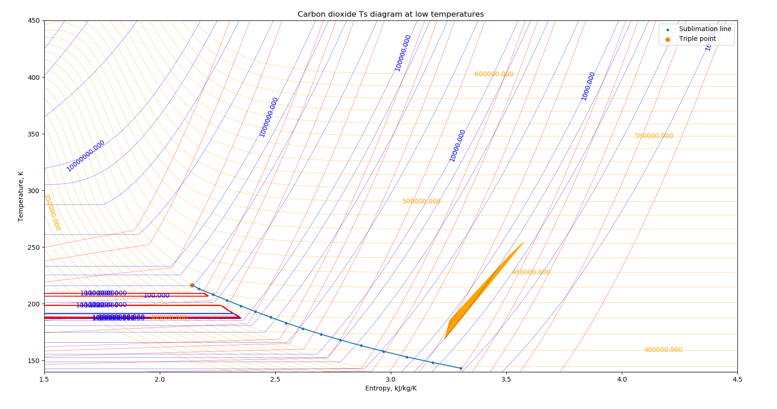
Ts diagram – now tabulated

Slide 22
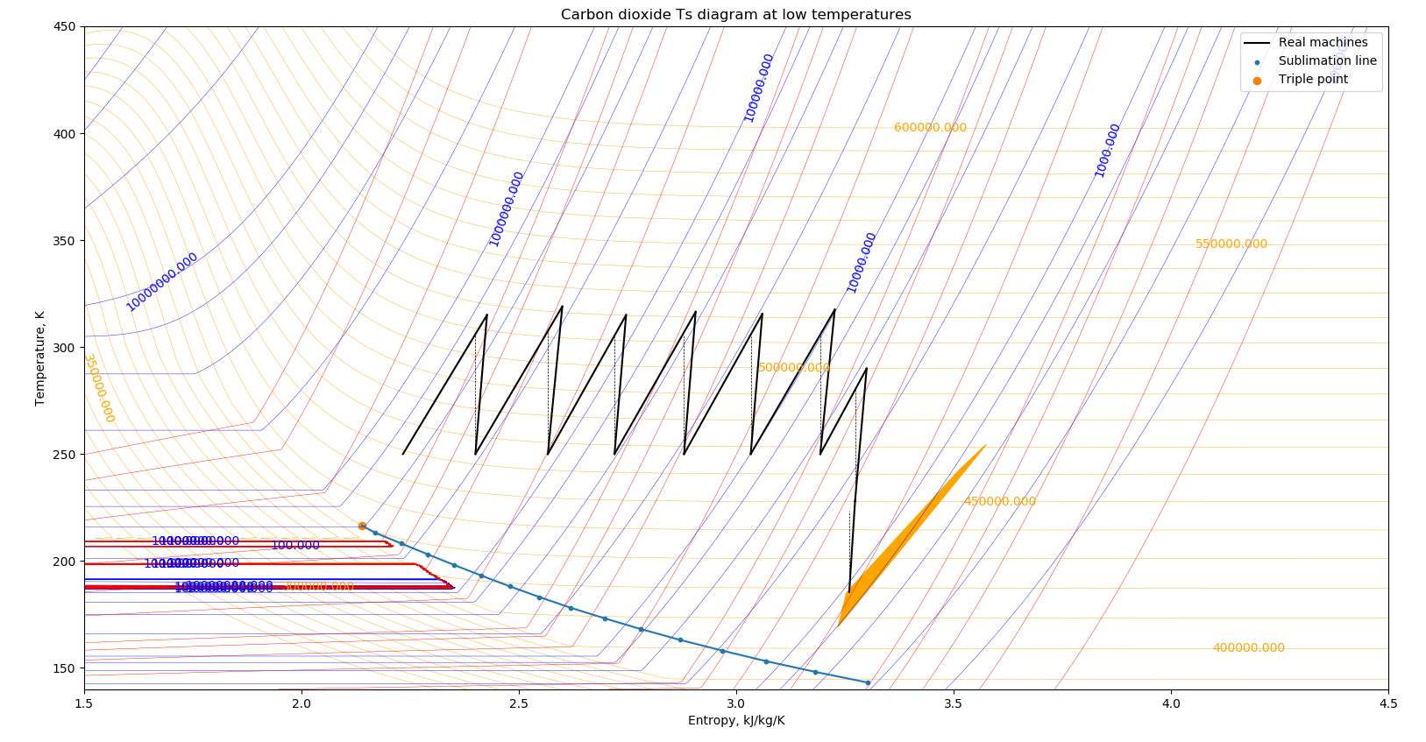
Arbitrary process plotting

Slide 23
Preliminary sensitivity analysis
Machine properties fixed – vary P_{out}
Baseline assumptions
First unit PR=2.1 (8 axials)
Each subsequent PR=2.4 (centrifugal)
Axials η=89%
Centrifugals η=83%
Intercooling to 250K
5% pressure loss in intercoolers
Intercooler temperature is critical parameter, then inlet temperature
Variable | Output p | Specific work (kJ/kg) | Change
Baseline | 6.37 | 409.7
Ideal machines | 8.67 | 340.2 | -16.96%
η-10% first unit | 6.37 | 416.1 | 1.56%
η-10% last unit | 6.37 | 417 | 1.78%
IC pressure drop +10% | 6.17 | 408.8 | -0.22%
IC pressure drop -10% | 6.79 | 411 | 0.32%
Inlet T +10% | 6.37 | 418.3 | 2.10%
Inlet P -10% | 5.79 | 409 | -0.17%

Slide 24
Martian system – bits and pieces
Week M2+M3

Slide 25
CO2 nuance
Different value of γ
Max pressure ratio in centrifugal is ~94% that for air
Speed of sound is 78% of air, lower choke speed
First stages: relatively close to sublimation line
Possible limits on diffusion factor to prevent icing
Margin is ~40K at low pressure, ~40K at high pressure, less inbetween

Slide 26
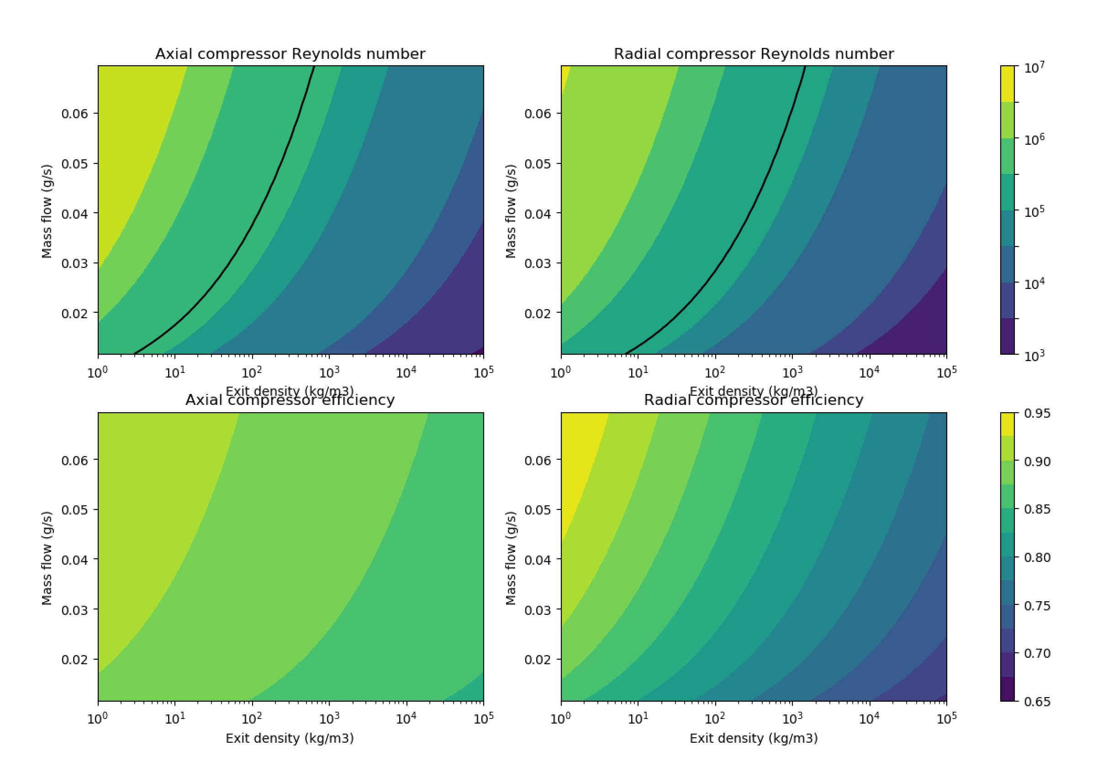
Machine scaling framework
Calculation of Reynolds number based on specific speed/diameter for each machine type
Simple efficiency scaling (Re^x)
Suggests highest Reynolds number at inlet (large diameter)
Higher efficiency for higher flow machines
Many many assumptions
Arbitrary blade speed
Arbitrary loading
Arbitrary scaling

Slide 27
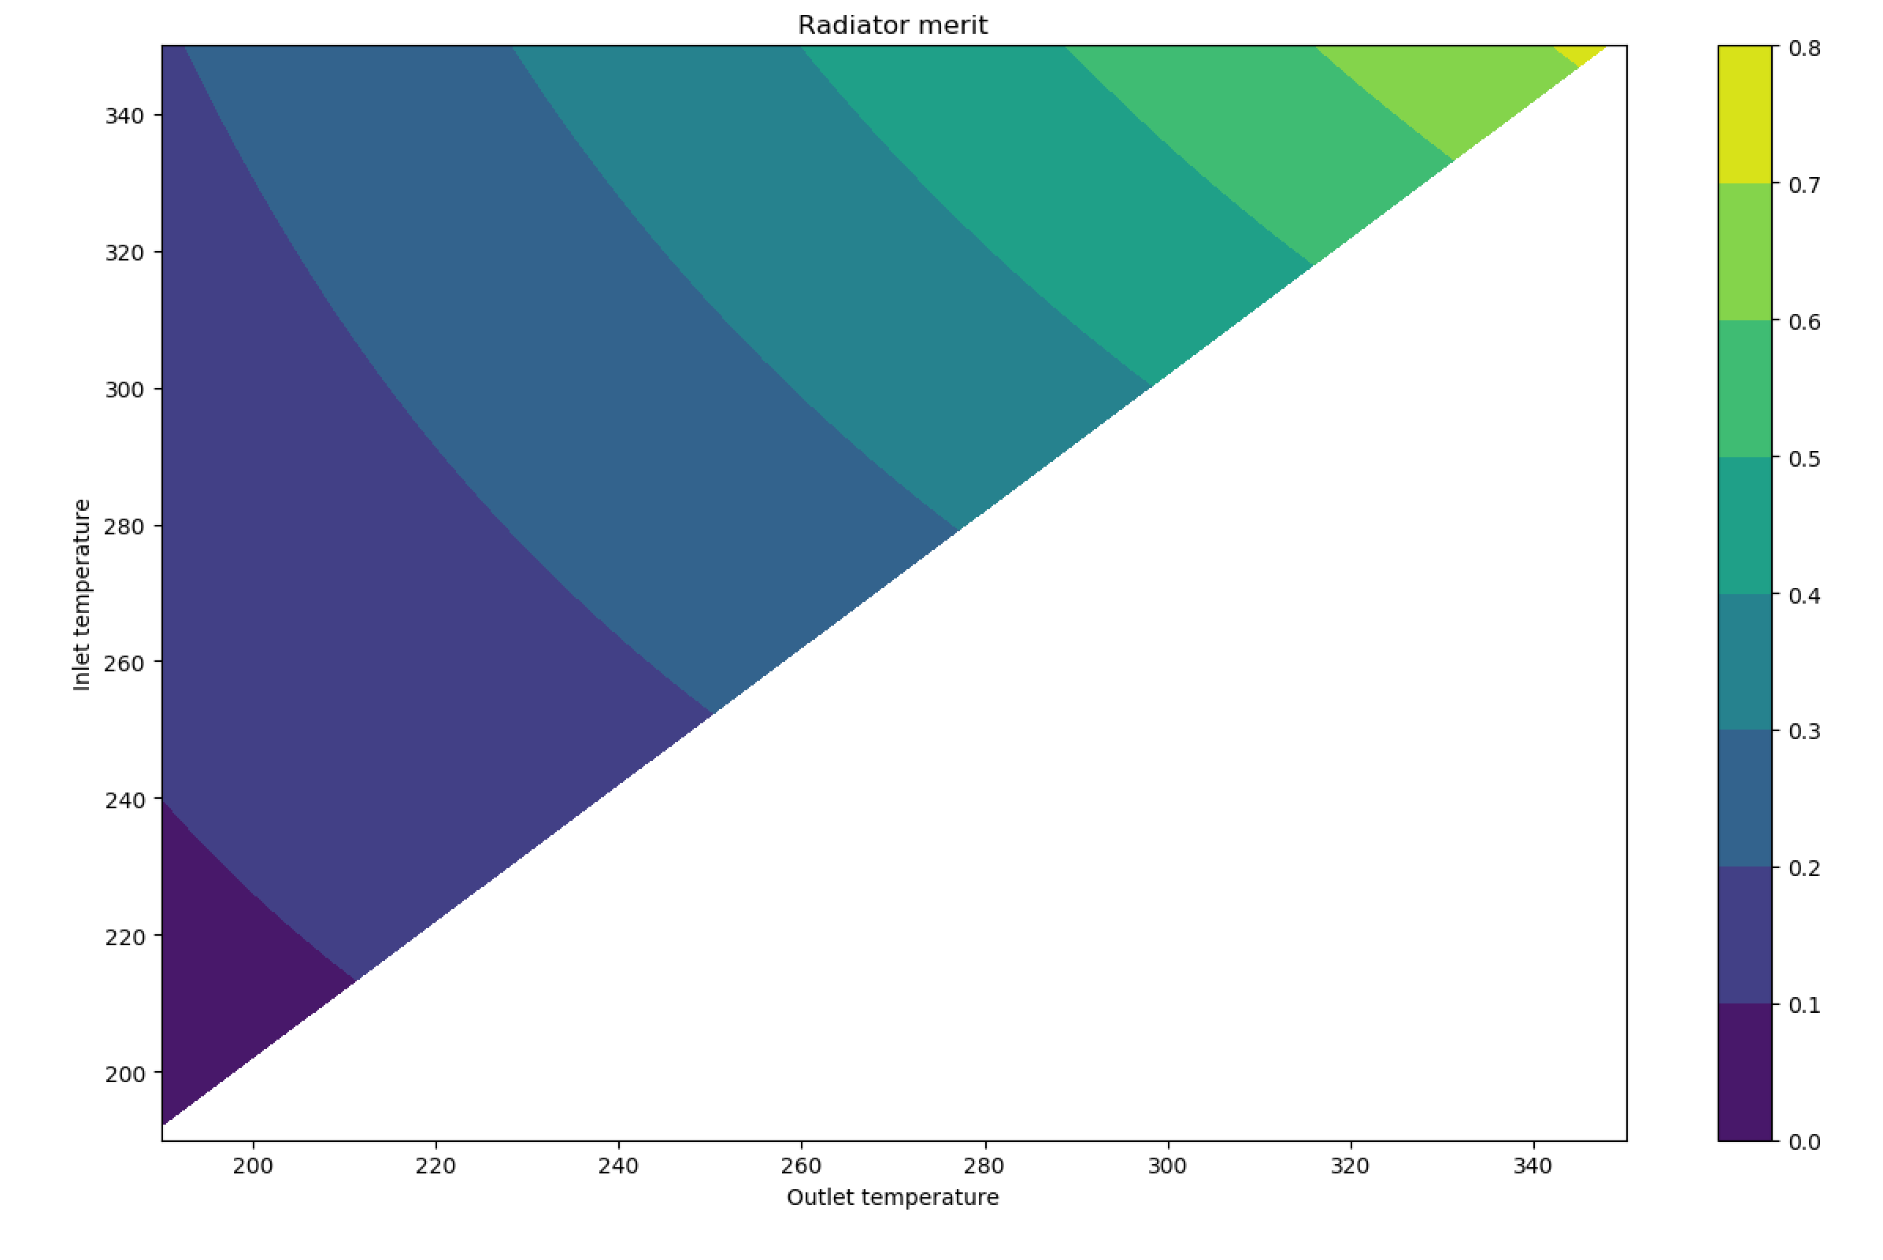
Radiator merit
Basic calculation for radiator effectiveness
Proportional to ΔT/L
Higher temperature = more effective
Greater delta = less effective
Proposed point (330K-250K) is at merit ~0.28, 43% of maximum

Slide 28
Donald Rapp, “Use of extraterrestrial resource for human space missions to Moon or Mars”
2018 literature review book by NASA ISRU specialist
Some additional insights
Revises performance floor for cryocoolers up by 2.5x, 2900kJ/kg
Current systems are performing at 93% of theoretical
0D scaling estimates 6x energy reduction versus theoretical
“Soft floor” for zeolite-based sorption pumps with current technology
16% w/w CO2 adsorption, 250K temperature swing
1445kJ/kg CO2
5 cycles per day –> 1000kg/day = minimum 1250kg of zeolite

Slide 29
Rapp: atmospheric dust properties
Cites Deirmendjian haze model
Validated by Curiosity MSL data (Lemmon et al, 2018)
Average particle radius 0.66μm
Mass-weighted average radius 2.5μm
Average 4 particles per cubic centimetre
Dust storm condition: order of magnitude higher, larger particle sizes
1.5E+08 particles per kg CO2
14μg of dust per kg CO2
5kg dust per year of operation

Slide 30
Weight estimation
Week M2, M3, M4

Slide 31
Weight estimation
Axial compressor: Sagerser scaling laws
Centrifugal compressor: model casing and cone weight only
Assume circular profile, include some crude margin for diffuser
Thicknesses set by pressures
Heat exchanger: surface area based on required heat transfer
Reynolds scaling of gas stream only
Motors: based on electric aircraft design formulae
Cryocooler: comparison of current space-grade systems
Freezer structure: geometric scaling

Slide 32
Weight estimation: assumptions
Centrifugal outlet blade height >2mm (larger better)
Stage efficiency falls into the machine
Motor speed < 100,000RPM
Density inputs from Ts diagram used
Centrifugal inlet radii set by specific diameter rules
HX: 0.5mm wall thickness, 5mm diameter tubes

Slide 33
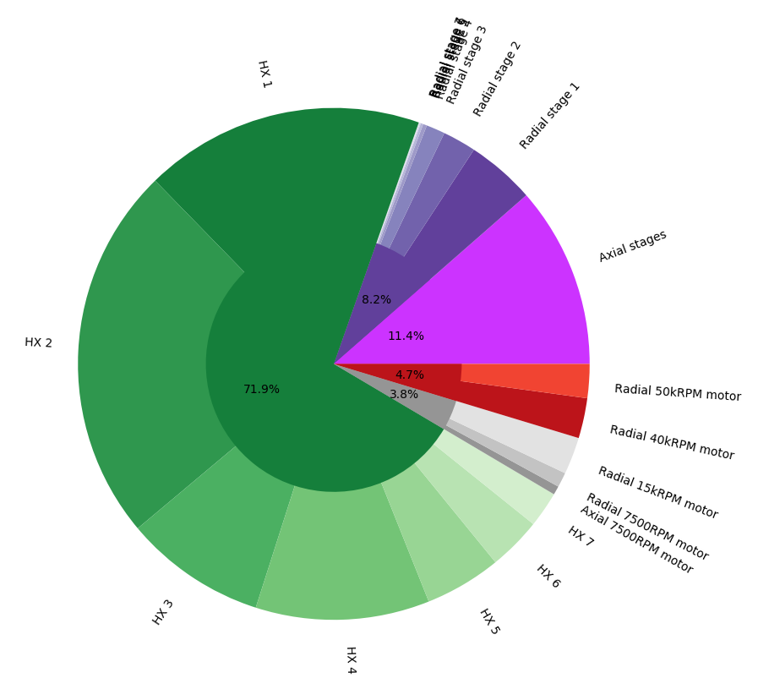
Weight assumption: results @ 50g/s
330kg system weight
40kW system power
Cryocooler comparison
8600kg system
259kW
Compares very favourably
96% weight, 85% power reduction
Equivalent System Mass
Cryocooler 78,530kg
Turbomachine 8,500kg (89% reduction)

Slide 34
Waste heat utilisation
Week M5

Slide 35
Waste heat utilisation
Extracted heat during compression: 370kJ/kg @280K average
During liquefaction: 345kJ/kg @210K average
Stoichometric ice: all values per kg CO2
Energy to heat ice to melting point: 136kJ/kg_{eq} @254K average
Energy to melt ice: 273kJ/kg_{eq} @273K
Ice heat + melt provides 110% of heat sink for compression
57% of heat sink for compression + liquefaction

Slide 36
Waste heat utilisation
Ice heat + melt provides 110% of heat sink for compression
57% of heat sink for compression + liquefaction
Practicality for utilisation depends on extraction architecture
In-situ thermal mining: probable makes it impossible
Opportunities for “cycle subchilling” seem very promising
13% energy savings from dropping intercool temperature by 10K
Good question for Paul Wooster (SpaceX) in end-of-term update

Slide 37
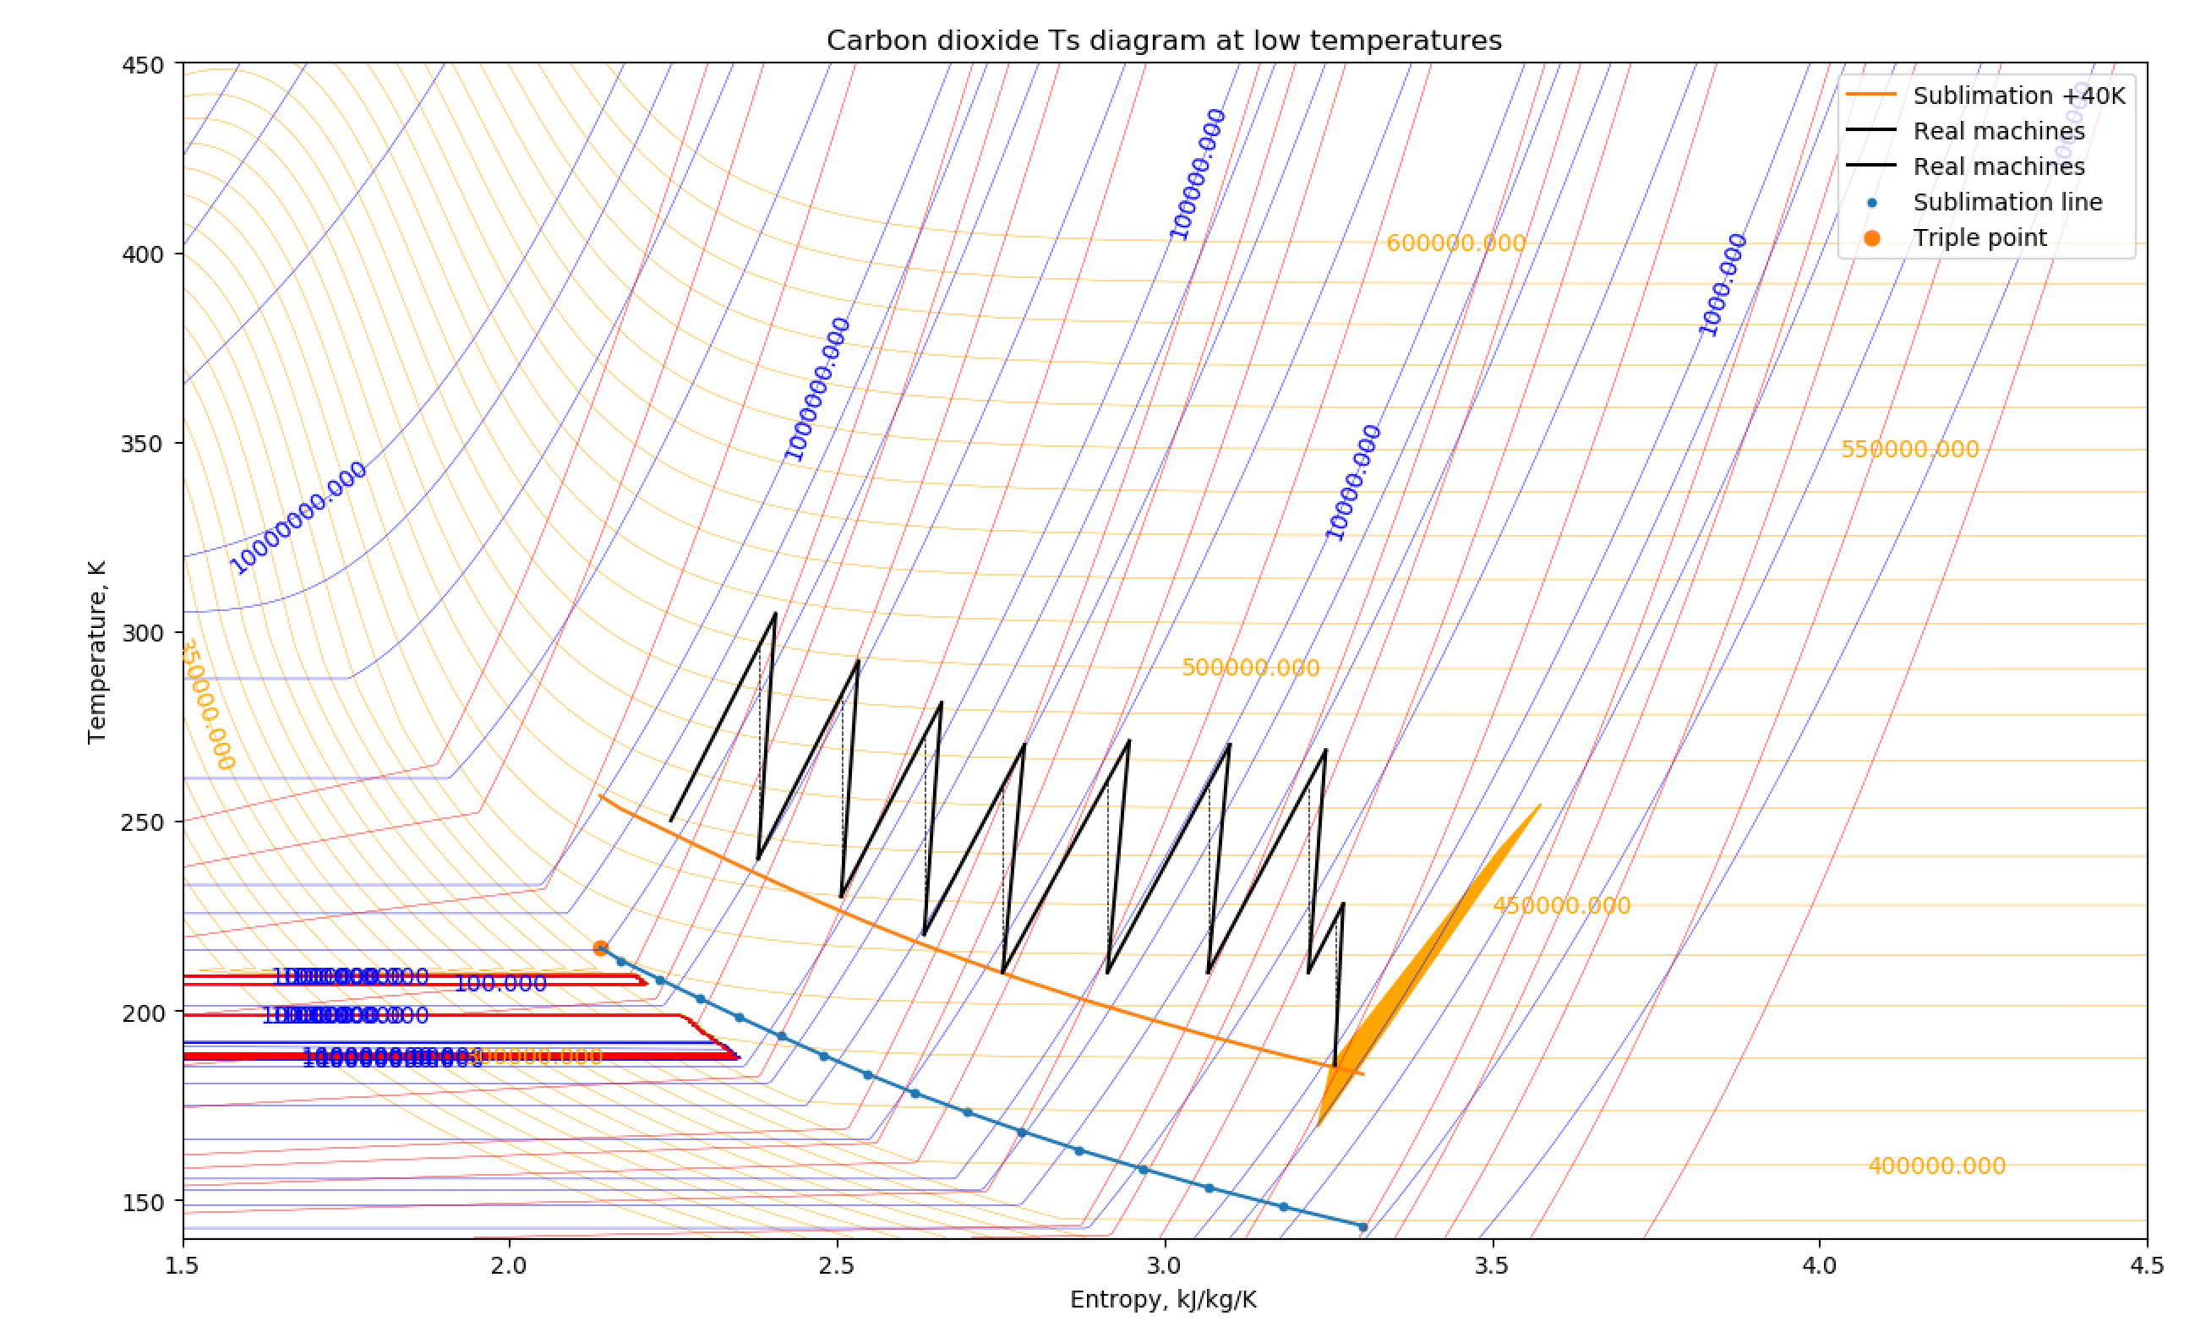
Example WHU cycle
Intercool temperature is greater of 210K, 40K above sublimation line
10% energy savings
12% cooling savings
Potentially reduce heat rejection ESM by 50% or more
Water melt system already required, no additional system mass
At least 10% ESM savings
With optimistic heat rejection mass reductions: 22% ESM savings

Slide 38
ESDU 92013 – Heat Exchangers
Air-cooled HX – suggests ΔT>15K
Typical air cooled HX might be 25mm OD steel tubes with 50mm aluminium fins
Crossflow HX: Mean temp difference = 0.7*LMTD
Standard values for U
Shell/tube with “process water”: 100W/m2K with “low pressure gas”
Plate/fin with “low viscosity hydrocarbon liquid”: 260W/m2K
Air-cooled: 700W/m2K with “treated water” - adjust down for density

Slide 39
Proposed next steps
Week M5, M6

Slide 40
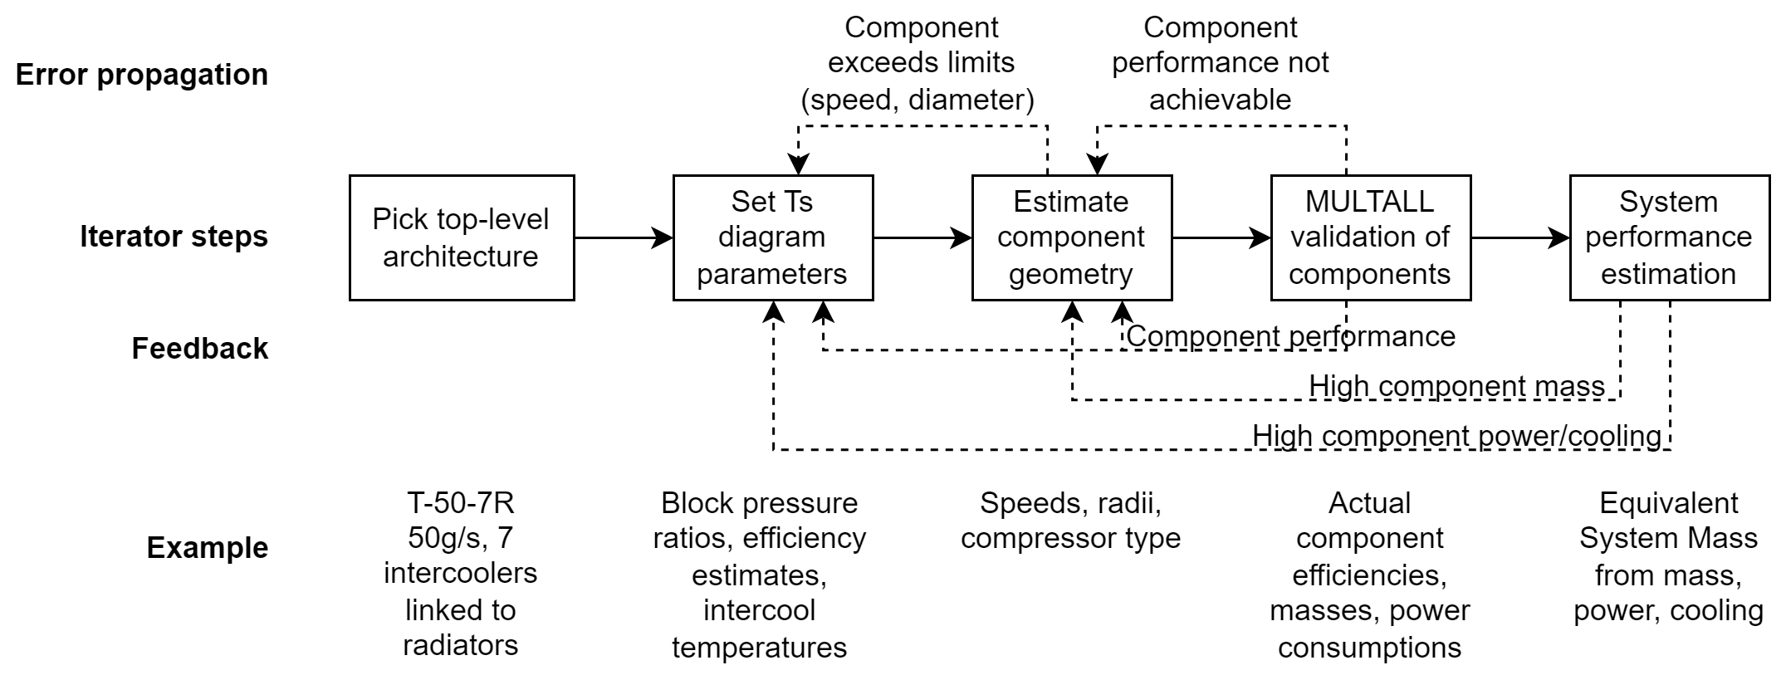
Proposed solution search architecture

Slide 41
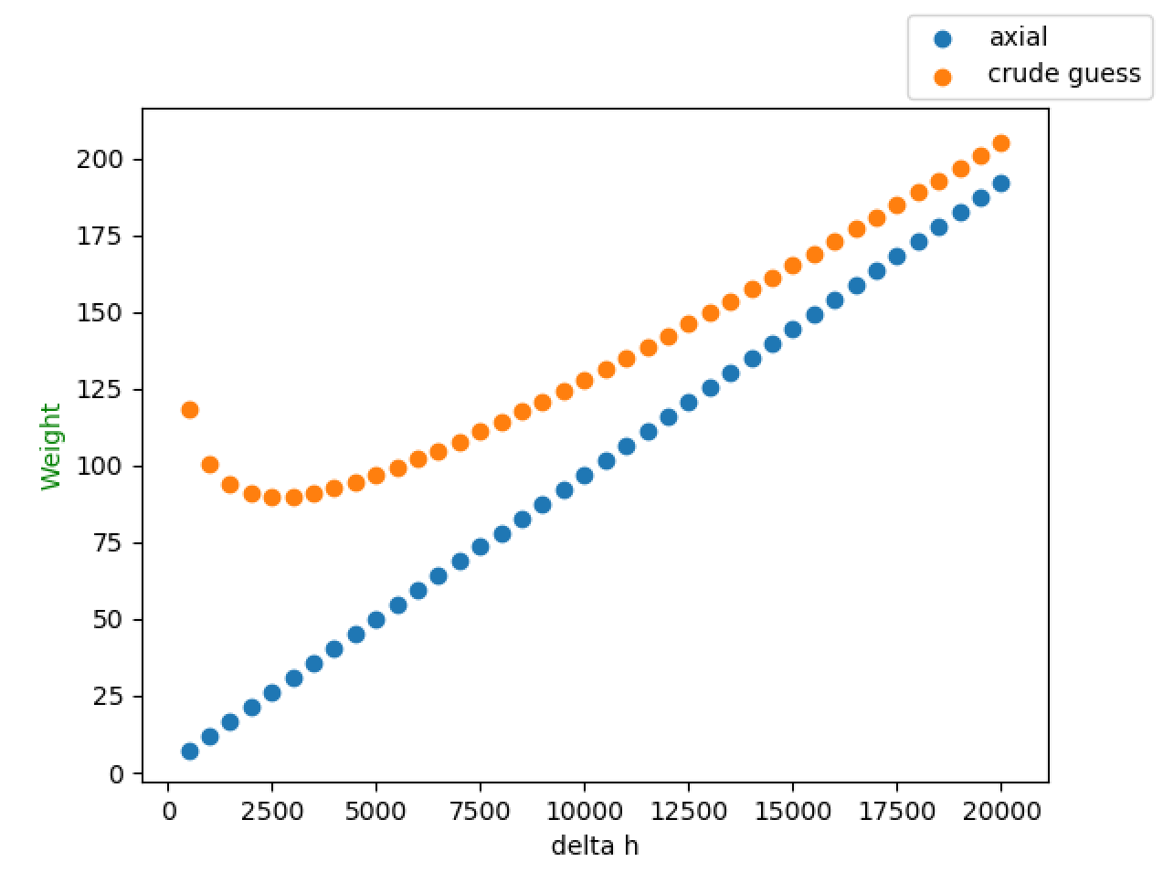
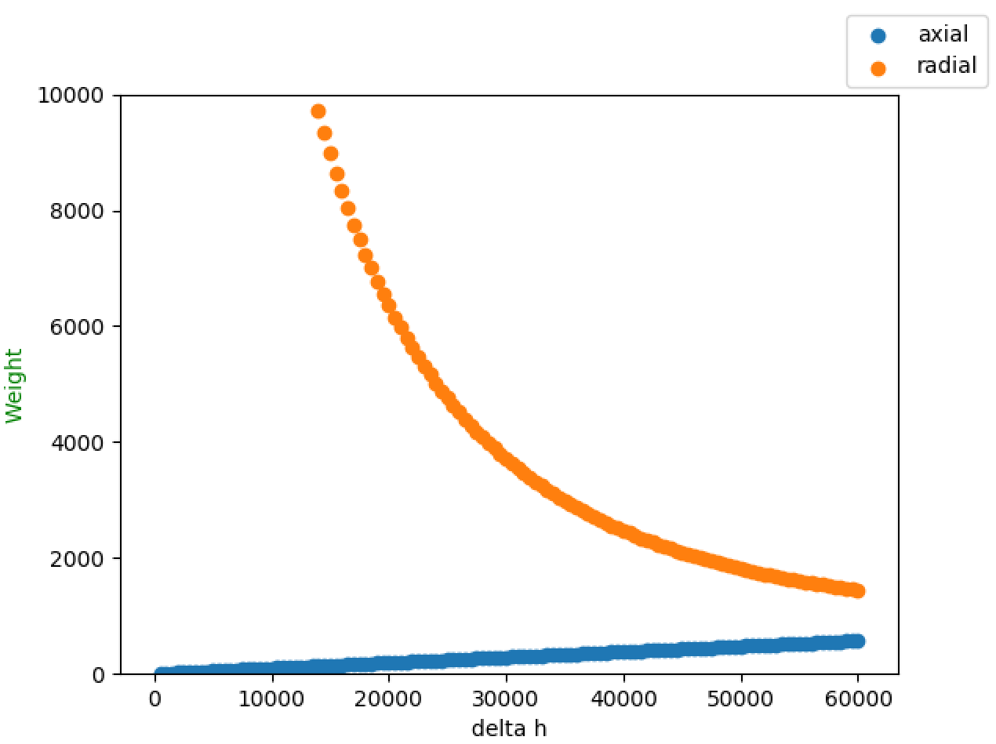
Single-component ESM optimisation!
Optimisation of geometric parameters to reduce ESM of one component
Comparison of components at a given performance (900Pa, 190K input)

Slide 42
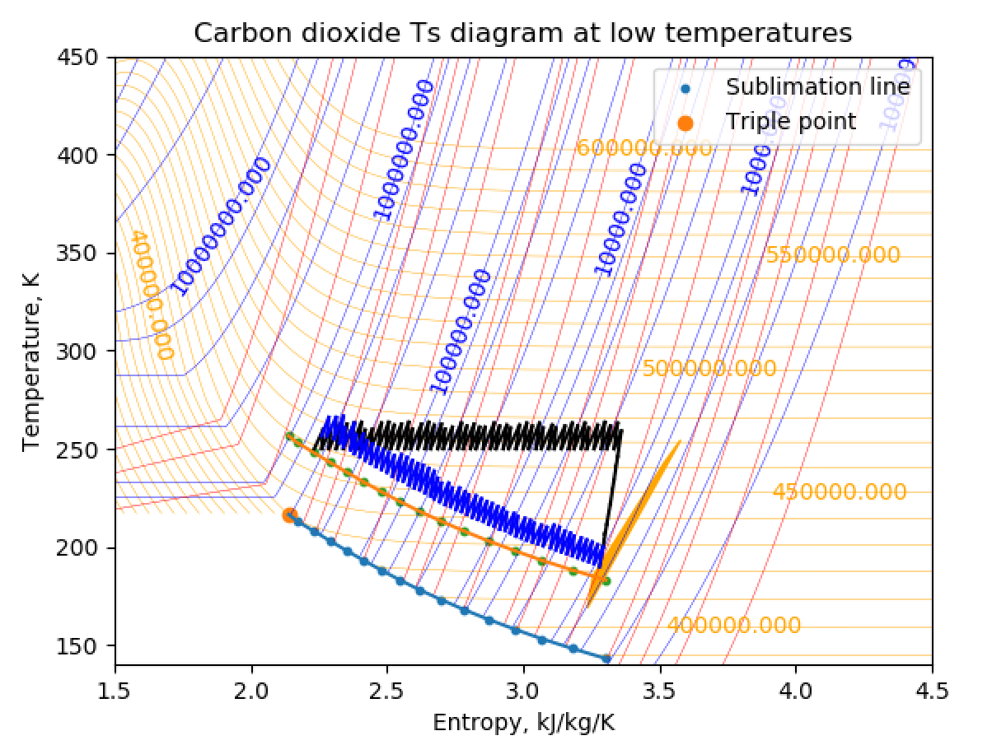
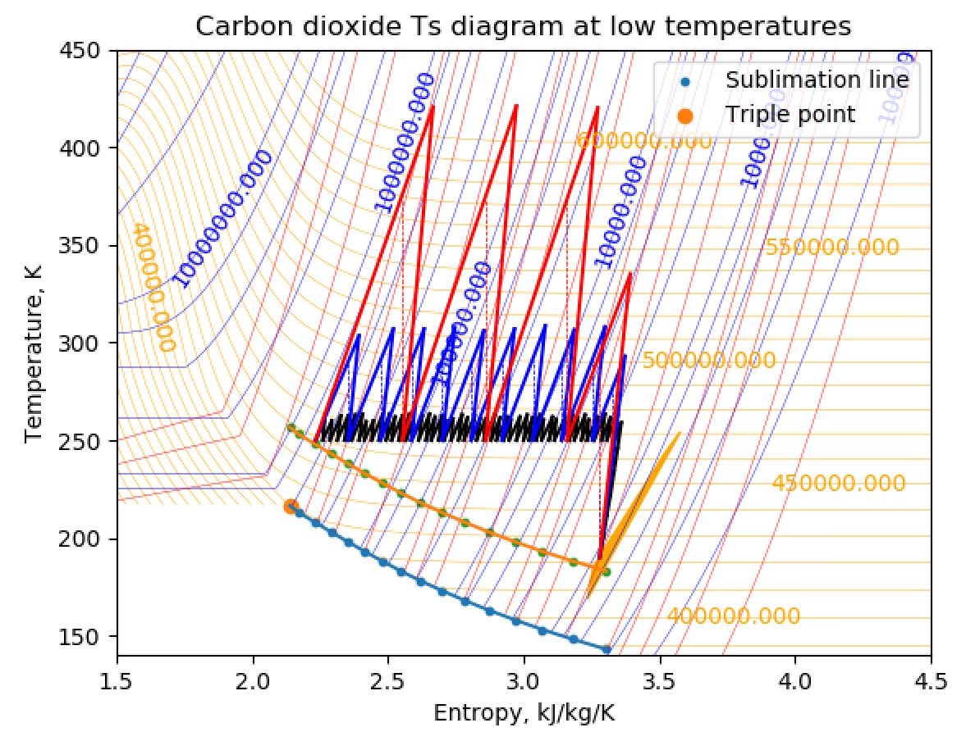
Cycle generation from architecture

Slide 43
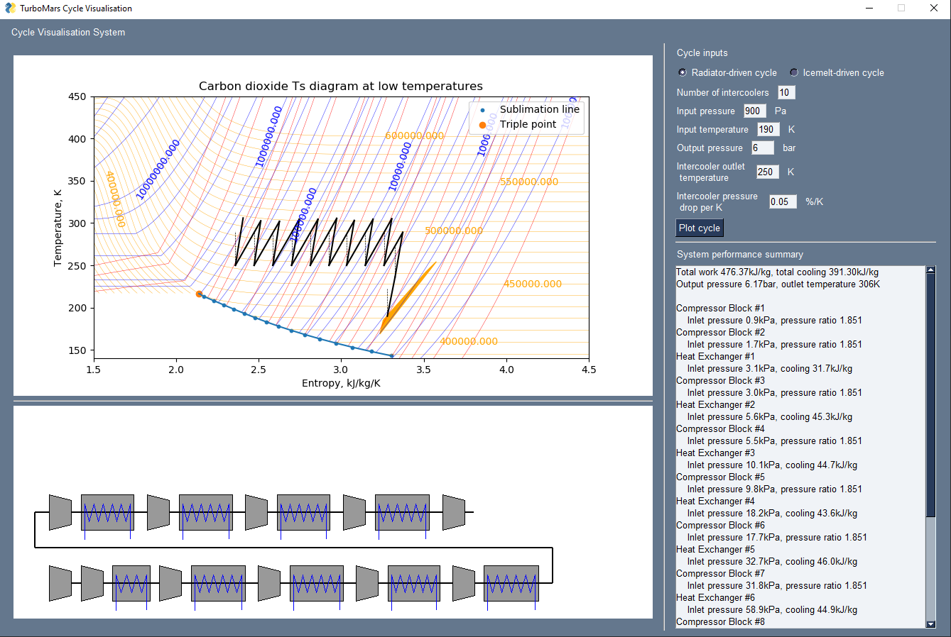
System designer GUI

Slide 44
Extreme examples
Real mass is small fraction of ESM
Baseline: 4.4% is mass, 1.1% is comp!
Reduce ESM: reduce power and cooling demands
Increase number of intercoolers
Mass of HXs is fairly invariant with #
10 ICs: 11xPR1.9 units
25 ICs: 26xPR1.3 units
Would this be 220kg heavier?
Component efficiency |  | 70%
Intercooler pressure drop |  | 0.05%/K
Mechanical efficiency |  | 80%
Input pressure, temperature |  | 900Pa, 180K
Target pressure, temperature |  | 6 bar, 220K
Number of intercoolers | 2 | 10 | 25
Flow work kJ/kg | 554.4 | 476.3 | 461.3
Total cooling kJ/kg | 502.3 | 462.7 | 448.5
Power ESM kg | 4193 | 3602 | 3490
Cooling ESM kg | 3742 | 3447 | 3341
Power + cooling ESM kg | 7935 | 7049 | 6831
Improvement (kg) | 0 | -886 | -1104

Slide 45
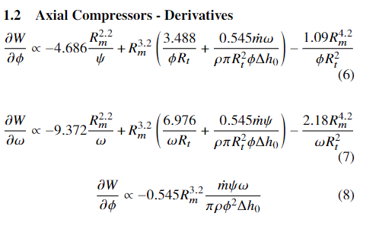
Solving equations to optimise mass
Not friendly!

Slide 46
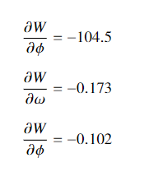
Order of magnitude mass scaling
W=17.9kg
In contrast
d(efficiency)/d𝜓 ~ 3-10%
d(efficiency)/d𝜙 ~ 1%
1% change in efficiency ~ 1% change in power
Power is ~40% of ESM
Therefore
𝜓 1->2: Weight -0.5kg, efficiency -3%, power +3%
ESM weight -0.1%, ESM power +1.2%
Almost always best to go for optimal efficiency

Slide 47
Scipy optimisation
Week M7, M8

Slide 48
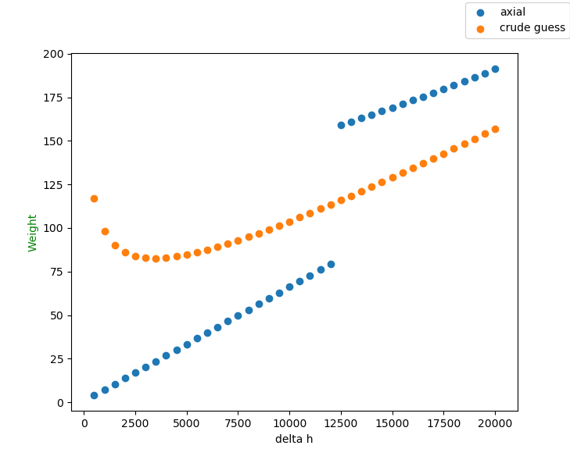
Scipy optimisation with complex constraints
All optimisers can bound input parameters (φ, ψ, ω)
Scipy ‘trust-constr’ allows for better constrained optimisation
Can take arbitrary function calls for constraints on output
Constraints on derived geometric properties
Seems to respect actual physical limits
PR = 1.36
30% mass reduction

Slide 49
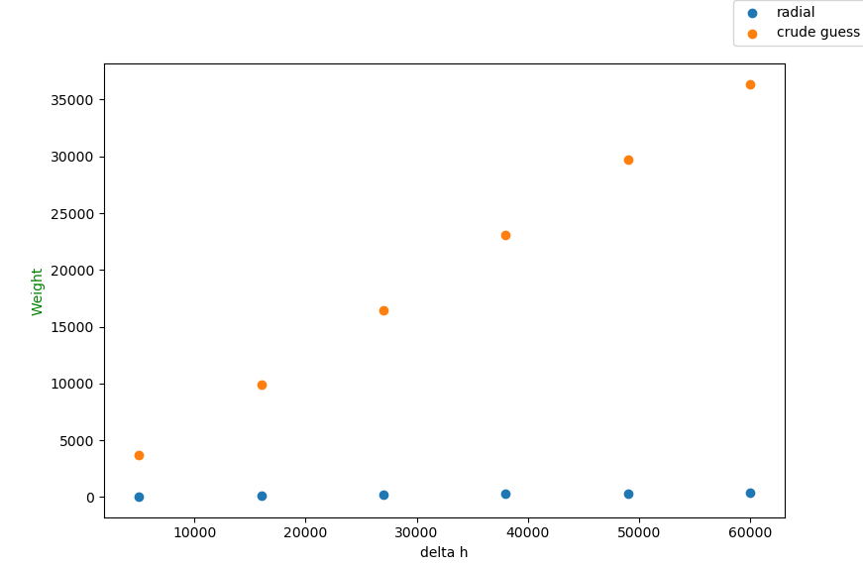
Radial optimisation
Takes O(2 minutes) per optimisation
Need to explore speedup options
Very substantial mass reduction, brings to reasonable values
100-400kg
Seems to be pursuing less aggressive stage loading, higher speed
ψ=0.85, in line with max efficiency
10kRPM for highest work stage

Slide 50
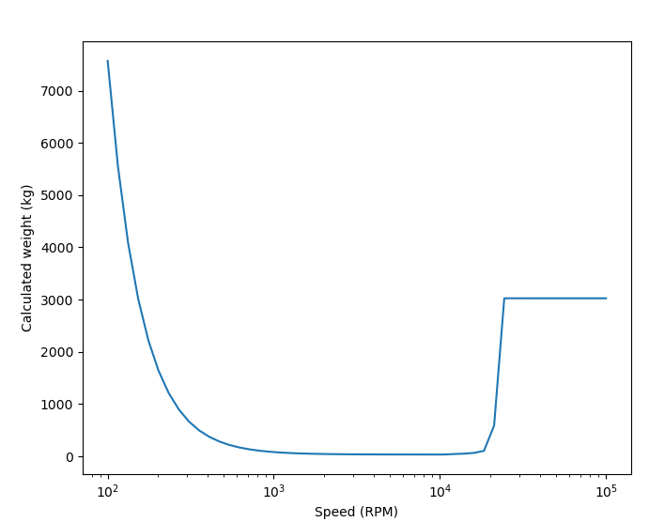
Manual cost function
Move to Nelder-Mead optimisation strategy
Manually input cost function
When some physical limit is exceeded, add constraint mass
Ramps in linearly to aid optimisation
Generally works well but seems to find strange “optimals”
Bladeheight limit kicks in
Limit of performance from Smyth – sets η=1%
PLACEHOLDER

Slide 51
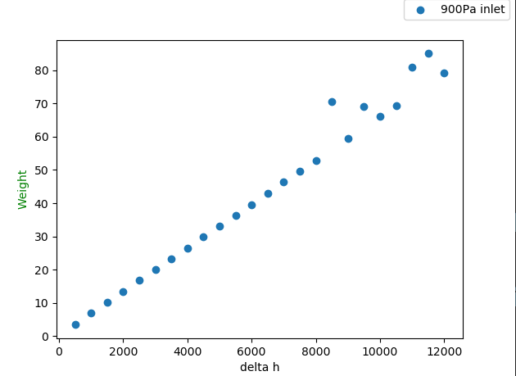
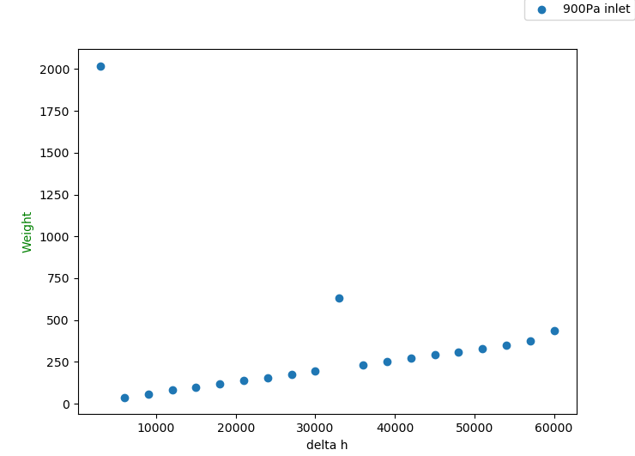
Effect of new cost function

Slide 52
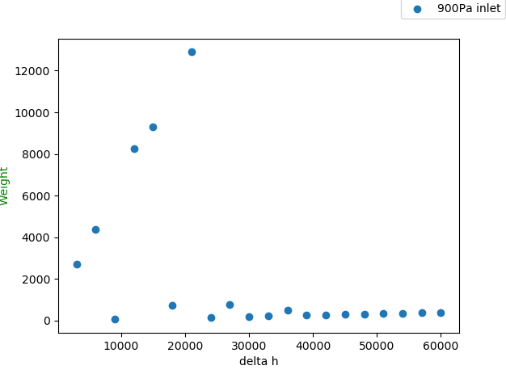
Trying to explain behaviour
η=1%
η=28%
η=47%
η=63%
Line: η=94%

Slide 53
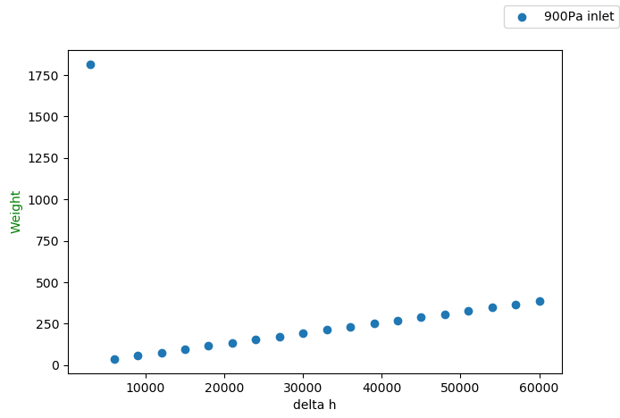
Removing physical mass from optimisation
η=1%
Line: η=94%

Slide 54
Post-Christmas

Slide 55
Fixing the optimiser

Slide 56
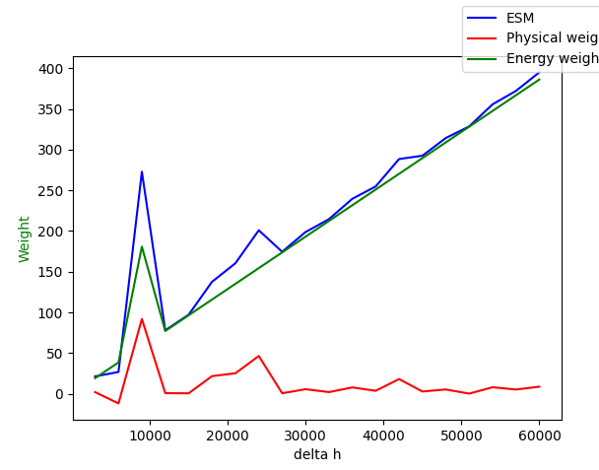
Change of initial conditions
Sped up calculation
Swapped some minimisation for analytic solutions inside calculation
0.18s per optimisation
Improved initial guesses
Not sure what’s going on with physical weight
Runtime doubles to ~0.37s
???

Slide 57
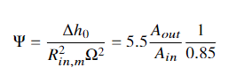
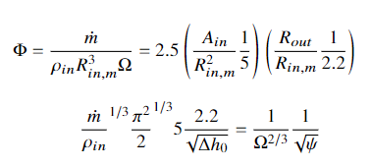
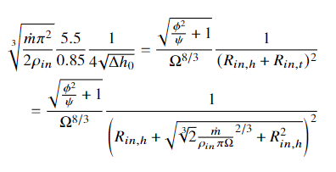
Improving compressor optimisation
Determined relationship between parameters for optimal condition
Not too sure how to make best use of these

Slide 58
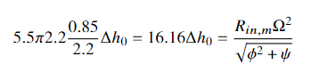
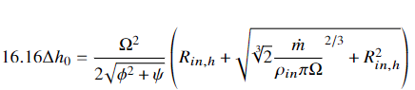
Single equation optimisation

Slide 59
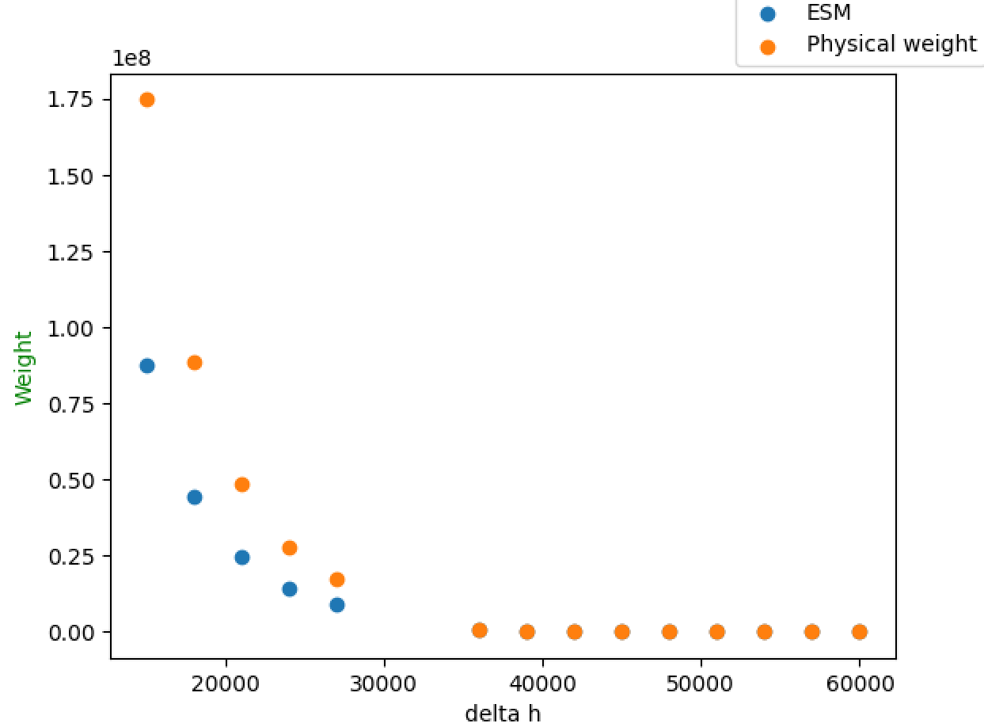
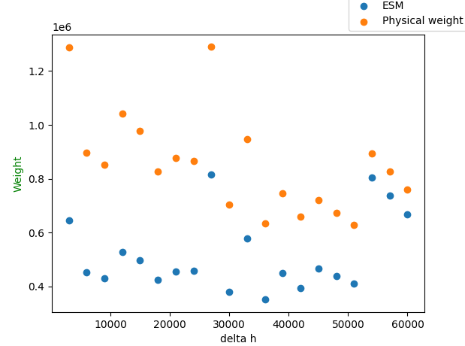
Reducing to single equations doesn’t seem to work
One equation
Some efficiencies are 94%, still comedically wrong
Two equations, minimising both
Every efficiency is 1%, no clue what’s happening

Slide 60
Output of optimiser
 | N blocks | PR/stage | Input pressure kPa | Mean inlet radius mm | Outlet radius mm | Bladeheight mm | Speed kRPM | Stage weight kg | Equivalent axial | Equivalent axial kg
Radial | 15 | 1.542 | 0.9 | 64.4 | 83.6 | 38.4/11.6 | 24.7 | 2.91 | 1.45 | 1.45
 | 15 | 1.542 | 100 | 12.1 | 15.5 | 4.18/1.63 | 100 | 0.08 | 39.65 | 39.65
 | 10 | 1.87 | 0.9 | 36.9 | 56 | 26.3/12.7 | 100 | 1.44 | 2.03 | 2.03
 | 10 | 1.87 | 100 | 10.6 | 18.8 | 4.79/1.16 | 100 | 0.14 | 51.73 | 51.73
 | 7 | 2.361 | 0.9 | 46.5 | 71.3 | 49.6/10 | 27.4 | 2.07 | 2.61 | 2.61
 | 7 | 2.361 | 100 | 12 | 48.6 | 4.22/0.73 | 100 | 1.18 | 66.51 | 66.51
Axial |  | PR/stage | Input pressure | Mean radius |  | Bladeheight | Speed | Stage weight
 |  | 1.1 | 0.9 | 57 |  | 86.9 | 10.9 | 0.29
 |  |  | 100 | 255 |  | 3 | 7.2 | 7.39

Slide 61
Issues
Immediately ran into global/local minimum issues
Centrifugal compressors: 5-variable space, local minima likely
Would be nice to find a way to visualise this
Optimiser seems to get “into a rut”
Efficiency halts at 30% or less
Changing initial guess causes dramatic change in output

Slide 62
Failed solutions! Lots of them

Slide 63
Basin-hopping
Solution: basin-hopping
Local minimisation interspersed with “hops”
Can escape local minima and better find global minima
Results in a more random process
When number of hops is low, solver is no longer determininstic
Finds different minima on each usage

Slide 64
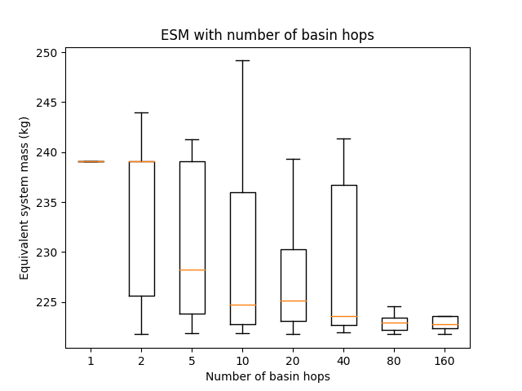
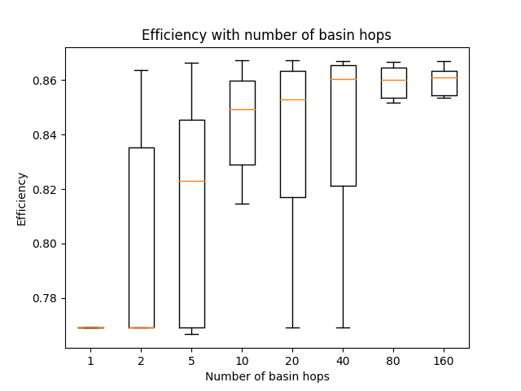
Evolution of the solution

Slide 65
Basin-hopping characterisation

Slide 66
Optimal number of hops
Time penalty is reasonable considering improvement in performance
N=4 selected for now
Reasonable slowdown
Better performance considering optimality

Slide 67
Actual solution

Slide 68
Nelder-Mead algorithm
Takes a simplex (=N-dimensional triangle) based on input values
Scipy default simplex: vary each value by +5% in turn
But we have well-defined extrema for each dimension
Practical limits for speed, hub radius, diffusion factor
Aerodynamic limits for work and flow coefficient
Use these as to create extrema of simplex
Simplex thus spans entire region between 80% of specific speed/diameter-based initial guess and maximum values
Extends to arbitrary dimensions

Slide 69
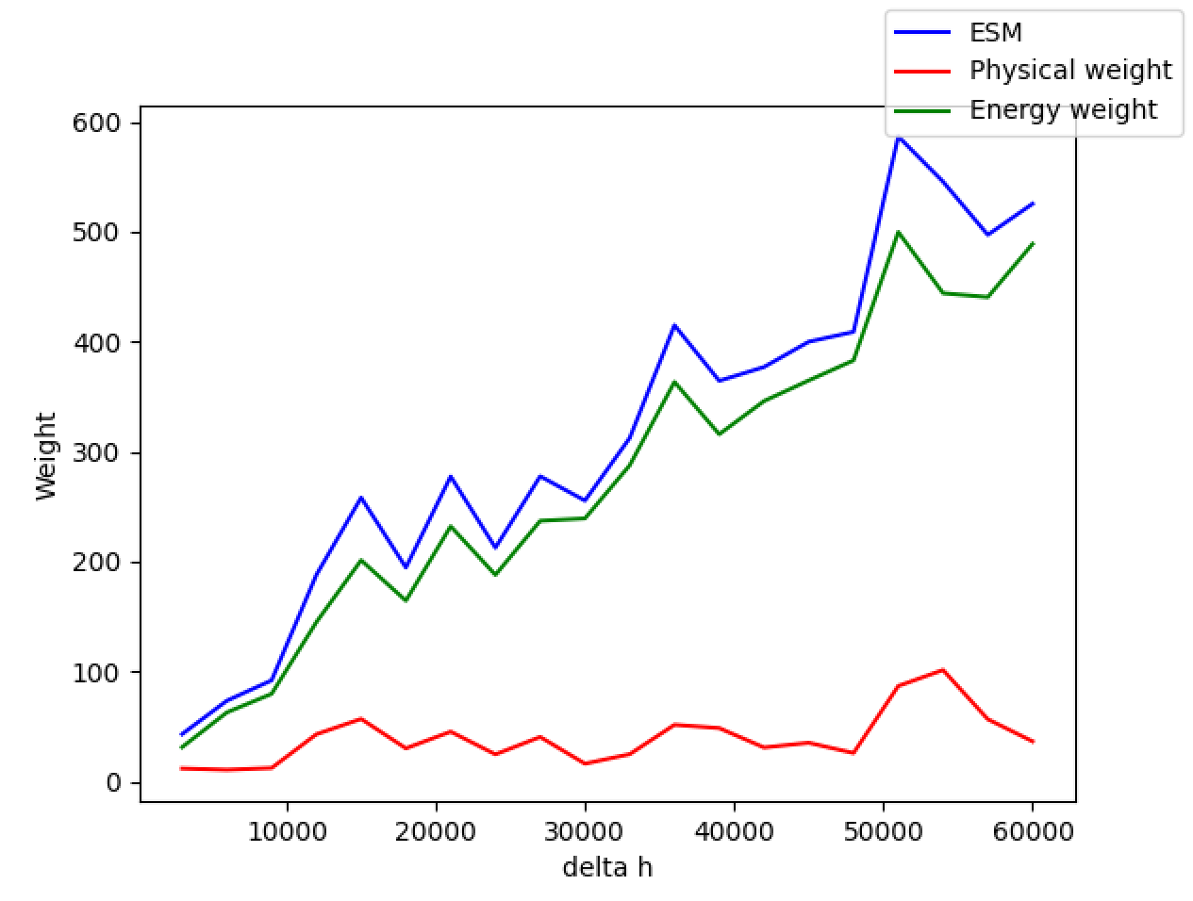
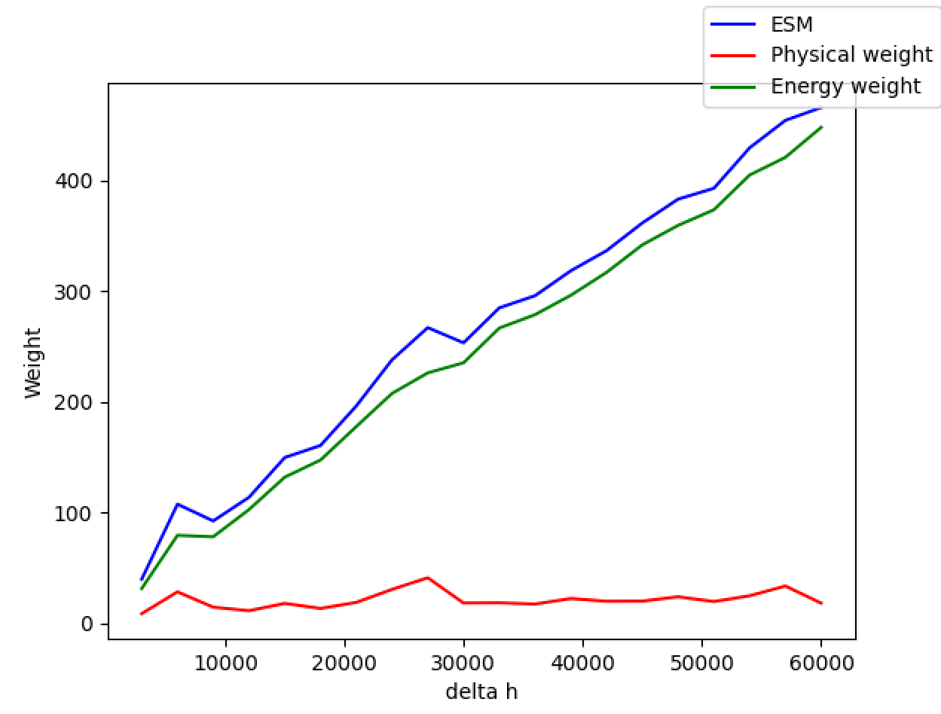
Effect of custom simplex
Using Scipy default simplex
0.37s per optimisation
Custom simplex
0.25s per optimisation, 20% reduction in max ESM

Slide 70
Advanced HX model

Slide 71
Heat exchanger advanced model
Improved calculations for HX mass and design model
Thermal resistance from wall and coolant-wall interface
Pressure drop based on actual data
Thermopedia as secondary source, references listed but not followed through
Coolant pressure drop and pumping power significant factors
Switch to low-viscosity low-temperature coolant fluid
Therminol VLT
Explore other options in future – supercritical helium? Liquid CO2?
Notes:
Motivated in no small part by REL interview

Slide 72
Design cases considered
Near-inlet HX
Near-outlet HX
1.9kPa, 230K
50g/s
1.14m3/s
Flow area from 10cm2 to 10m2
Velocity from 1140m/s to 0.114m/s
100kPa, 230K
50g/s
0.0217m3/s
Flow area from 10cm2 to 10m2
Velocity from 21.7m/s to 2.1mm/s

Slide 73
Design rules
Max diffusion area of 15
Limits minimum speed in HX to ~15m/s
Leads to 4m long diffuser near entry!
Near-entry case: 1.9kPa, 300K, 1.49m3/s
Inlet area 100cm2
Near-exit case: 100kPa, 300K, 0.028m3/s
Inlet area 2cm2
1mm copper tubes, 0.1mm wall thickness, 20K difference

Slide 74
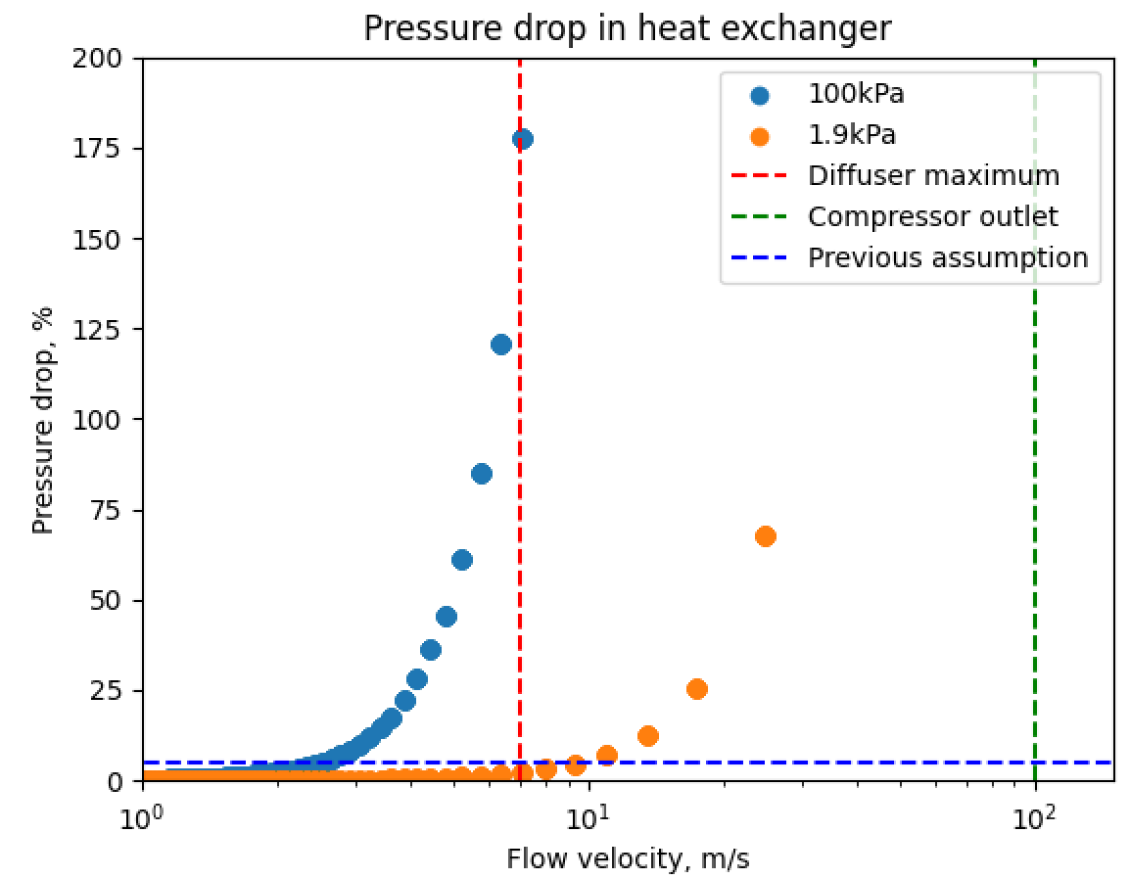
Pressure drop
Much larger problem than previously assumed
High flow velocities from compressor outlet = large losses
Extreme diffusion required to reduce losses
Bringing loss to 5% at HP needs speed of 2.5m/s
Diffusion ratio of 40

Slide 75
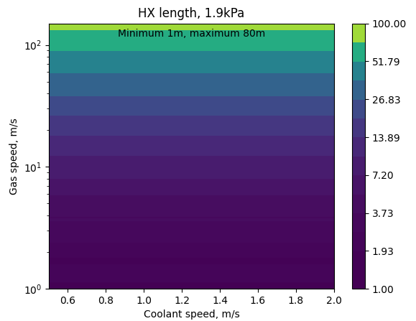
Underlying reason: very long HX
For 1.9kPa case, pressure drop per tube row is low but number of rows is large
Maximum of 872 tuberows!
New approach
Parallel-plate heat exchangers with crossflowing fluid
Notes:
Parallel plates:
http://www.electronics-cooling.com/2003/05/estimating-parallel-plate-fin-heat-sink-pressure-drop/
Cengel, page 437

Slide 76
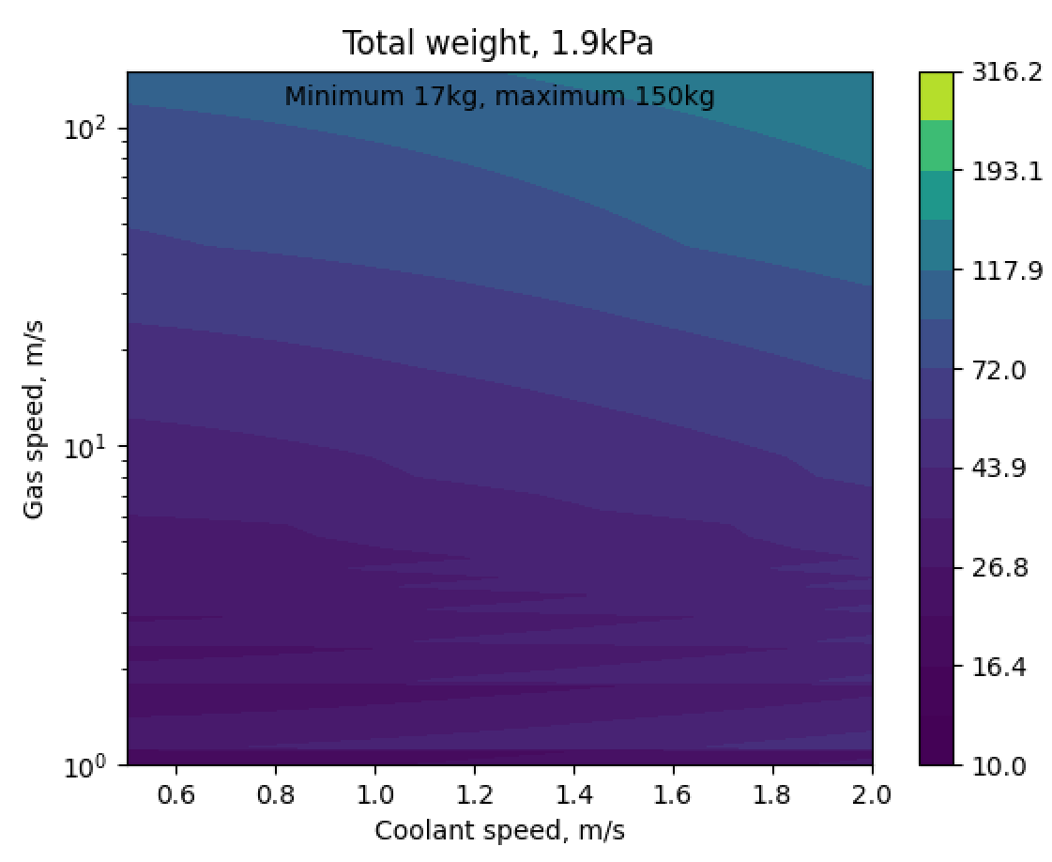
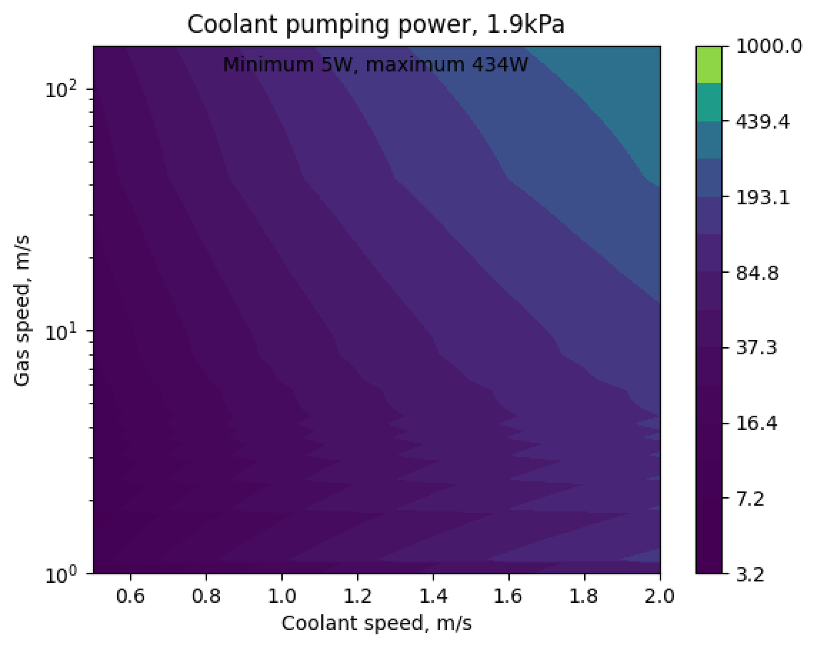
Weight and power model

Slide 77
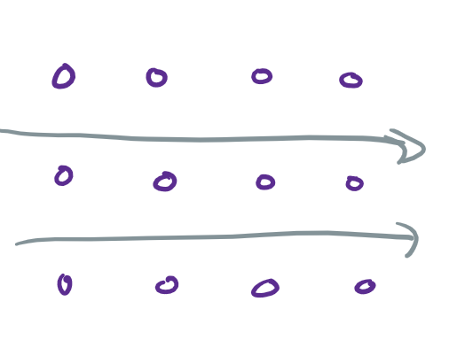
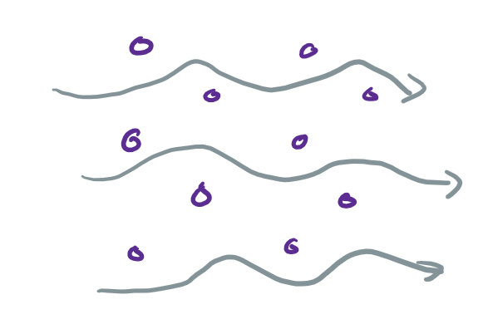
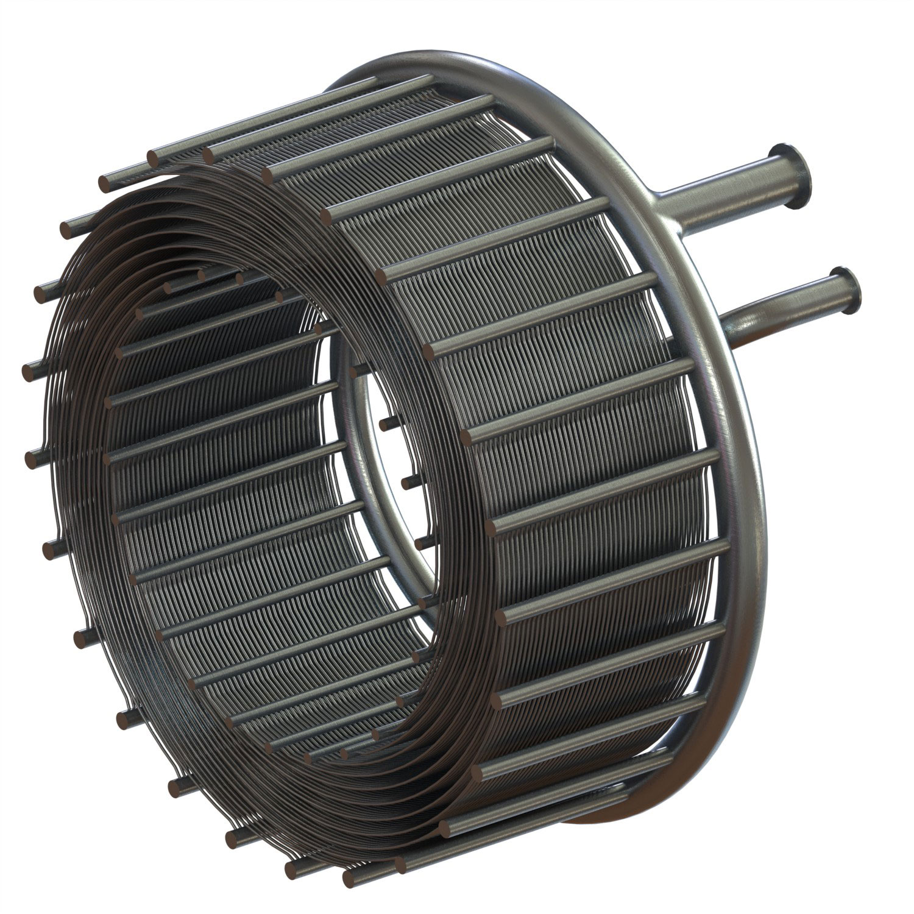
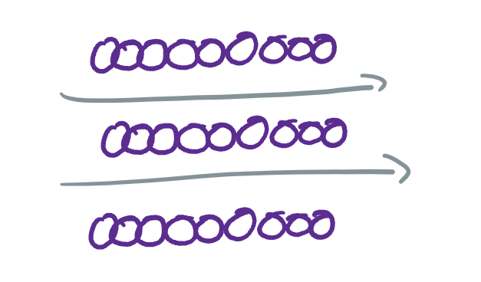
New geometry – sintered tubes
SABRE engine precooler – brazed microchannels

Slide 78
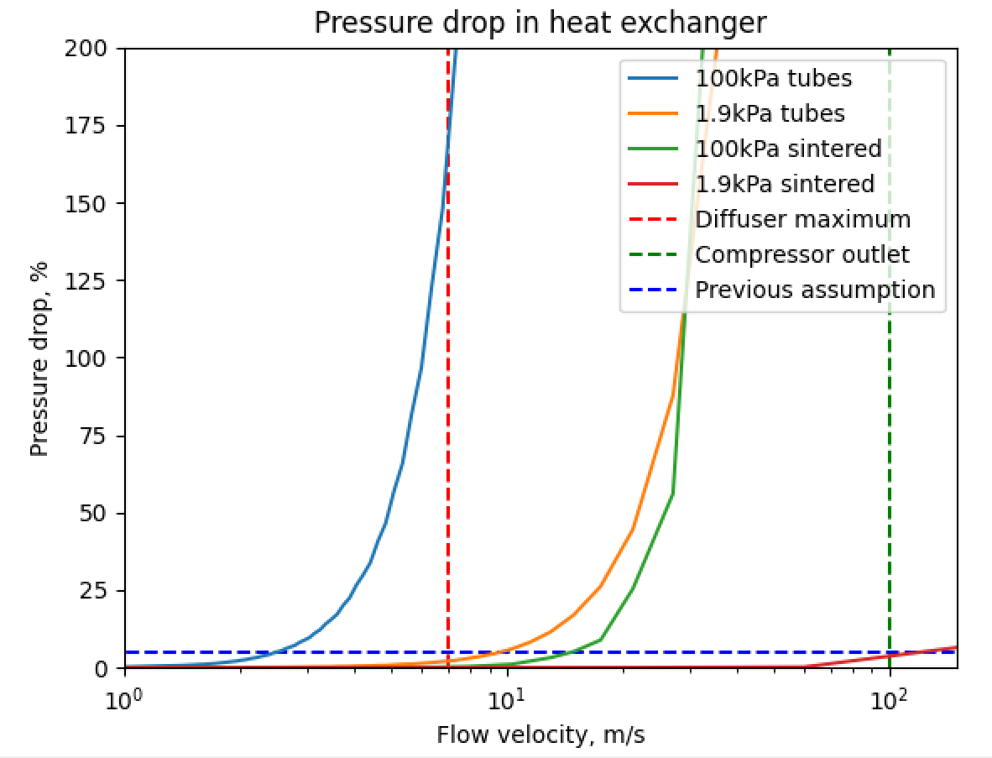
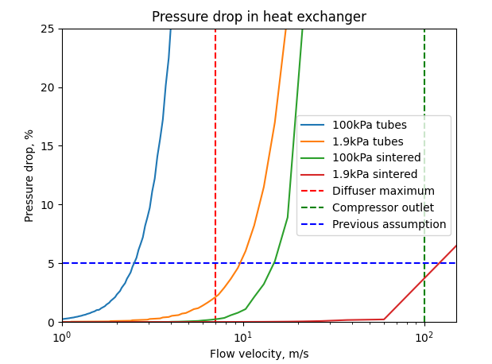
Pressure drop issues resolved

Slide 79
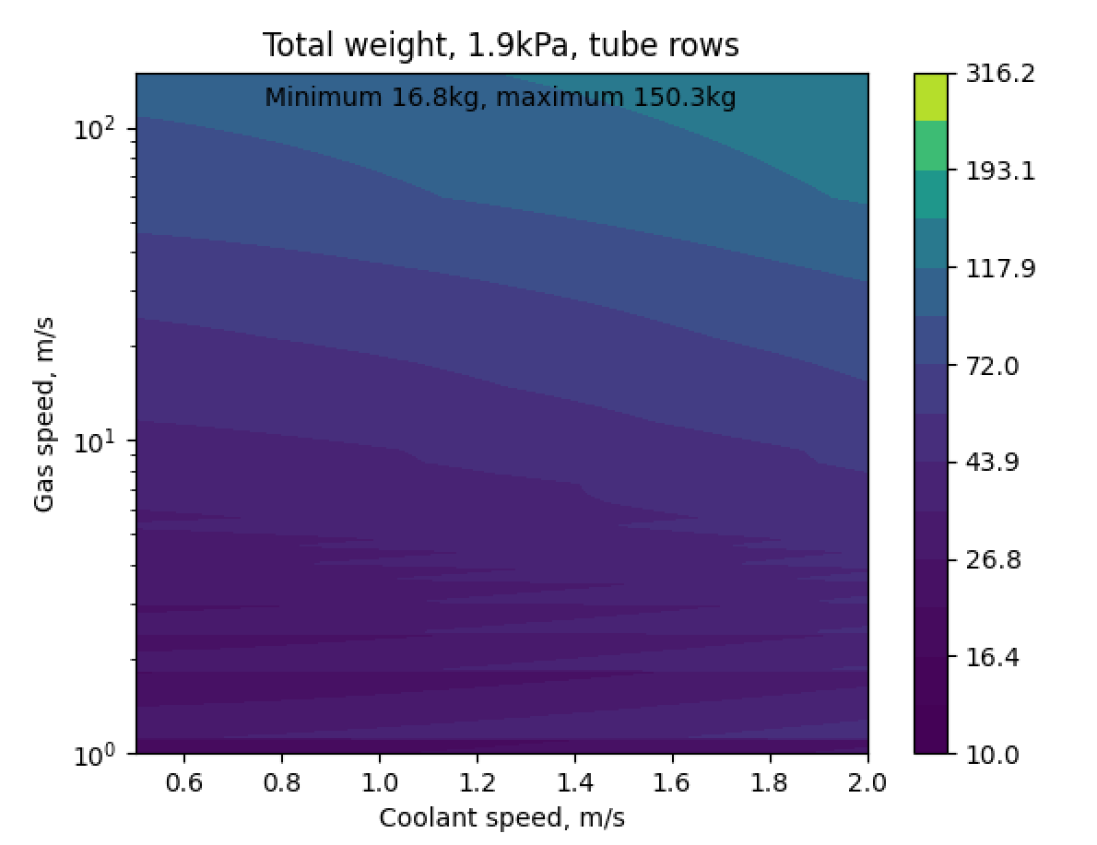
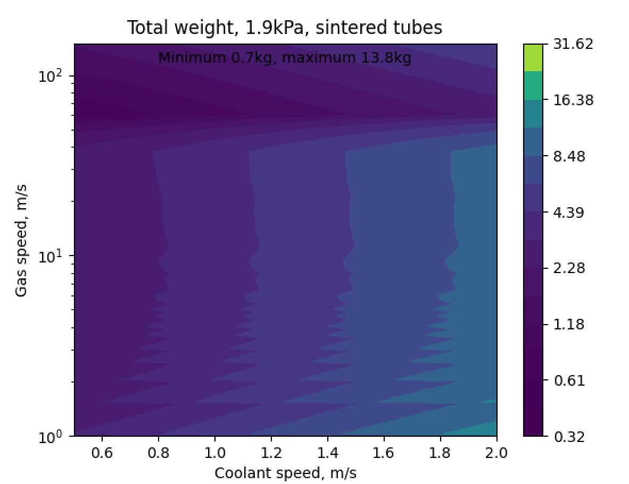
Higher HTC = less overall weight

Slide 80
Sintered-wall HX implications
Three design variables
Coolant speed (0.5-2m/s)
Gas bulk speed (10-150m/s)
Row spacing (pitch-to-diameter ratio) (1.25-20)
Low pressure drops with reasonable diffusion
Can access pressure drop from ~0% to infinity in practice
No constraint from this system – makes optimisation easier
Low weight
Definitely manufacturable (Reaction Engines)

Slide 81
Compressor stator modelling

Slide 82
Axial compressor
η_{stator} = η_{rotor}
Maximum η_{stage} =85%
Target value = 89%
Implies η_{stator} =97%
Not sure best approach to handle this difference

Slide 83

Centrifugal compressor
Used rectangular duct diffuser efficiency map
Assume we always lie on the maximum efficiency line
Sets L/W, η_{stator} for a given diffusion factor
Logarithmic spiral blade shape
Sets L for a given area ratio
Determine all dimensions, number of blades, weight

Slide 84
Stators in the solver
No effect for axials – no new calculations
Centrifugals
Adds one additional dimension of optimisation
Almost no impact on execution speed - 0.4s per design, up from 0.37s
System is making intelligent tradeoffs
Maximum η_{stage} for centrifugal is 87% (diffusion factor=15)
Seems to aim for η_{stage} ~73% (DF ~ 3.8)
Reducing emphasis on weight by 20%: aims for η_{stage} ~81%
Reducing by 40%: aims for maximal η_{stage} ~87%
Apparantly non-linearity in emphasis

Slide 85
Whole-system optimisation

Slide 86
Previous baseline
Non-optimised machines
η =85% axials, 73-65% centrifugals
Stator weight, HX weight, HX performance all modelled very crudely
Item | Weight (kg) | Power (kWe) | Cooling (kWe) | ESM (kg)
Compressor weight | 110.2 |  |  | 110.2
HX weight | 239.9 |  |  | 239.9
HX cooling |  |  | 18.5 | 2238.5
Motor weight | 28.3 |  |  | 28.3
Motor power |  | 40 |  | 5960
Batteries |  |  |  | 1111.1
Total | 378.4 | 40 | 18.5 | 9688.0

Slide 87
Single-item optimisation
ESM table | Weight | Power | Cooling | ESM
Axial compressor | 0.76 |  |  | 0.76
Centrifugal compressor | 88.38 |  |  | 88.38
HX weight | 2445.0 |  |  | 2445.00
HX cooling |  |  | 18577.6 | 2247.89
Condenser weight | 394.16 |  |  | 394.16
Condenser cooling |  |  | 3620.0 | 438.02
Coolant pump weight | 12.69 |  |  | 12.69
Coolant pump power |  | 4277.8 |  | 645.94
Motor weight | 14.85 |  |  | 14.85
Motor power |  | 26335.0 |  | 3976.59
Batteries | 850.35 |  |  | 850.35
Total | 2955.8 | 30612.8 | 22197.6 | 11114.6
Like-for-like total | 2534.1 | 26335 | 18577.6 | 9623.8
Like-for-like change | +569% | -34% | +0.4% | -0.7%
Optimise each machine in turn, feeding in parameters from previous
Quick to run
O(1s) per machine, 19 machines
Definitely not truly optimal
Diffusers in comp and HX
Sharing of motors
Slight reduction in ESM but shift from power to physical weight
87.7% ESM reduction vs SotA

Slide 88
ESM breakdown in single-item optimised

Slide 89
Compressors in single-item optimised design
Machine | Pressure ratio | Inlet mean diameter (mm) | Impeller outlet diameter (mm) | Diffuser outlet diameter (mm) | Bladeheight (mm) | Speed (RPM) | Efficiency | Weight (kg) | Power (W) | ESM (kg-e)
Axial 1 | 1.1 | 68 |  |  | 45.48 | 58327 | 84.6 | 0.16 | 212.5 | 25.873
Axial 2 | 1.1 | 58 |  |  | 37.1 | 100000 | 84.6 | 0.13 | 218.2 | 26.532
Axial 3 | 1.1 | 58 |  |  | 37.17 | 100000 | 84.6 | 0.13 | 224.1 | 27.246
Axial 4 | 1.1 | 58 |  |  | 37.95 | 79791 | 84.6 | 0.12 | 230.2 | 27.974
Axial 5 | 1.1 | 56 |  |  | 35.36 | 100000 | 84.6 | 0.12 | 236.4 | 28.724
Axial 6 | 1.1 | 52 |  |  | 32.52 | 100000 | 84.6 | 0.1 | 242.7 | 29.467
Radial 1 | 2.775 | 71.1 | 117.9 | 869.5 | 19.7 | 45115 | 83.66 | 22.765 | 3020.3 | 388.22
Radial 2 | 2.775 | 86.5 | 102.1 | 841.5 | 7.9 | 48293 | 84.75 | 19.64 | 3344.5 | 424.32
Radial 3 | 2.775 | 36.1 | 49.3 | 639.7 | 6.1 | 100000 | 88.11 | 12.41 | 3216.7 | 401.63
Radial 4 | 2.775 | 30.9 | 97.7 | 653.8 | 2.29 | 100000 | 82.61 | 11.52 | 3431.1 | 426.68
Radial 5 | 2.775 | 25.5 | 66.63 | 634.4 | 0.864 | 100000 | 85.99 | 10.66 | 3296.2 | 409.5
Radial 6 | 2.775 | 20.86 | 90.64 | 656.9 | 0.323 | 100000 | 83.5 | 11.38 | 3395.1 | 422.19

Slide 90
HX in single-item optimised design
Machine | Pressure ratio | Cooling power (W) | Length (m) | Actual duct length (m) | Coolant pumping power (W) | Number of tube passes | Duct size (mm) | Weight (kg) | ESM (kg-e)
HX 1 | 0.96 | 1894 | 8.424 | 4.09 | 1530.8 | 151478 | 203.6 | 365.3 | 550.53
HX 2 | 0.96 | 3344.5 | 16.97 | 9.56 | 28.01 | 301329 | 170.4 | 170.4 | 173.79
HX 3 | 0.96 | 3216.7 | 7.16 | 4.006 | 459.4 | 168336 | 203.5 | 400.4 | 455.99
HX 4 | 0.96 | 3431.1 | 10.56 | 7.32 | 22.91 | 230706 | 151.6 | 410.5 | 413.27
HX 5 | 0.96 | 3296.2 | 64.2 | 56.5 | 36.8 | 818440 | 81 | 803.7 | 808.15
HX 6 | 0.96 | 3395.1 | 15.4 | 9.55 | 907.3 | 229248 | 108 | 294.7 | 404.48
Condenser | 0.94 | 3620 | 92.63 | 91.94 | 437 | 643552 | 47.6 | 394.16 | 447.04

Slide 91
Issues seen with single-item optimisation
Heat exchangers are extremely long
Increase allowable pressure drop per HX - currently an input parameter
Reduce wall thickness – REL has achieved 40 micron
Decrease fluid temperature – limits on radiator performance
Change to a different fluid with better performance
Later stage radials have very small bladeheights, tip gap issues
Strengthen solver bias away from these values – already very strong
Increase mass flow to make everything bigger
Replace final stages with piston/scroll

Slide 92


HX alternative coolant
Total weight = 2878kg
Total length = 123m

Slide 93


Alternative coolant – 20 bar supercrit He
Total weight = 2690kg (-6.5%)
Total length = 268m (+118%)

Slide 94


Alternative coolant – 20 bar liquid ammonia
Total weight = 2649kg (-8%)
Total length = 251.6m (+105%)

Slide 95

HX alternative coolant – liquid ammonia
Total weight = 2690kg (-6.5%)
Total length = 268m (+118%)

Slide 96
Diagnosing optimisers failure
All optimisers are failing on HX5, some on HX6
Maximum number of iterations exceeded
With some experimenting -> massive length excess can occur even when optimiser claims success
Possible approach – switch to minimising pressure drop for a given length, rather than setting pressure drop and finding other parameters
Need to find the ESM effect of high pressure drop

Slide 97


Crude ESM model
Optimum # of blocks is ~20! For these parameters

Slide 98

Effect of change in HX pressure drop
With 10 HXs
8.75% ↑ ESM per % ↑ pressure drop for all HXs -> 0.88% per % per HX
With 15HXs
12% ↑ ESM per % ↑ pressure drop -> 0.80% per % per HX
20 HXs
0.78%↑ESM per %↑pressure drop per HX
Overall: 0.8% ESM increase per % per HX, 80kg/% pressure drop in HX

Slide 99

Implementation of variable pressure drop #1
For 50g/s, 1% pressure drop = 80kg weight in the whole system
Just include that in the optimiser
Spits out some really weird results
Output space is probably too steep for Nelder-Mead to handle
Note that true ESM for this component is O(1e3 kg)
Constraints always violated

Slide 100
Implementation #2
Moving pressure drop into the N-M optimiser doesn’t seem to be effective
Solver always seems to encounter some kind of constraint
Move pressure drop out of the optimiser
Optimise with an input pressure drop, for a sweep of pressure drops
Choose the lowest ESM
Does necessarily involve some slowdown

Slide 101


Optimiser field with and without pressure drop
Pressure drop calculated from parameters provided
Pressure drop given, penalty applied if doesn’t match target, no constraint, best of 20 pressure drops for overall ESM

Slide 102

Only difference between these cases
Pressure drop in optimiser
Pressure drop outside optimiser

Slide 103

Exercise in efficiency maximisation
Bit of a side quest, but a question I’ve wanted to answer for a while
Is it possible to make a truly isothermal compression machine?
Temperature does not deviate from optimal line during compression process

Slide 104
Physical approach
Cylinder with cooled walls
Piston speed causes fluid to move at Vpiston/2
Fluid motion causes heat loss to walls
Piston also causes compression
Match compression rate to heat loss rate = isothermal compression!
Clearly possible for an infinitestimal period
Possible for continuous flow process? Or impossible

Slide 105


System behaviour

Slide 106

Governing equation
Length-diameter ratio of piston governed by speed of piston, temperature, heat transfer
Role of δt? Unclear
For continuous compression, L must decrease continuously
u is gas speed – piston speed is double

Slide 107


Calculation - δt=0.1

Slide 108

Result
Map of useful outputs
Consider a mid-range system, around 1m in maximum length
Starting at 221K, 10m/s
Length is 1m
Want a factor of 10 compression Temperature of 247.5K
Length should be > 0.1m
Speed must fall to <1mm/s

Slide 109
Conclusion
Contours of constant length would have to be much shallower for isothermal compression to be effective
Perhaps some very limited regions of effectiveness
These are set by transition between flow regimes – unlikely to be reliable or repeatable
Not a viable idea!

Slide 110
Documentation for models
All written up
121 individual equations!
Found one significant mistake
Thermal resistance calculation was messed up
Finding resistance per length of tube, not per surface area
Now fixed, heat exchangers perform much better

Slide 111
New HX optimisation approach
Lots of things tried, one approach stuck well
Start with a target pressure drop of 1%
Create an optimised heat exchanger
If pressure drop is less than target and heat exchanger volume is less than a certain level -> Accept!
Otherwise, multiply target pressure drop by 1.2
Repeat until target pressure drop is 25%
Works really really well

Slide 112
Improvement again – 27% ESM reduction
Previous model, 7 HXs
New model, 10 HXs
ESM table | Weight | Power | Cooling | ESM
Axial compressor | 0.76 |  |  | 0.76
Centrifugal compressor | 88.38 |  |  | 88.38
HX weight | 2445.0 |  |  | 2445.00
HX cooling |  |  | 18577.6 | 2247.89
Pre-condenser weight | 394.16 |  |  | 394.16
Pre-condenser cooling |  |  | 3620.0 | 438.02
Coolant pump weight | 12.69 |  |  | 12.69
Coolant pump power |  | 4277.8 |  | 645.94
Motor weight | 14.85 |  |  | 14.85
Motor power |  | 26335.0 |  | 3976.59
Batteries | 850.35 |  |  | 850.35
Total | 2955.8 | 30612.8 | 22197.6 | 11114.6
ESM table | Weight | Power | Cooling | ESM
Axial compressor | 0.76 |  |  | 0.76
Centrifugal compressor | 97.44 |  |  | 97.44
HX weight | 96.68 |  |  | 96.68
HX cooling |  |  | 17841.0 | 2158.76
Pre-condenser weight | 1.61 |  |  | 1.61
Pre-condenser cooling |  |  | 3620.0 | 438.02
Coolant pump weight | 5.01 |  |  | 5.01
Coolant pump power |  | 4.31 |  | 0.65
Motor weight | 17.41 |  |  | 17.41
Motor power |  | 29603.3 |  | 4470.09
Batteries | 822.43 |  |  | 822.43
Total | 218.9 | 29607.6 | 21461.0 | 8108.9

Slide 113
Results of improved model
Heat exchanger mass back to almost zero
Physical compressor, HX, motor weight is now 2.7% of ESM
Runtime is ~20 seconds!
Approximate total system volume is just 0.804m3
94% of this is heat exchangers
Speed in heat exchangers is 1-10m/s

Slide 114
Next problem: small blade spans on radials
Radials still have <1mm exit blade heights
Might be possible to change optimisation goals and avoid these entirely
Need a good model for efficiency reduction from this effect
If not, more options exist
Increase mass flow – currently running system for 5.5 hours, can reduce this
Switch from radial to reciprocating scroll compressor
MOXIE scroll: seems to have η_{p} = 36%! Not great at all

Slide 115



Casey and Robinson: different efficiency model for radial compressors
Defines an inlet total flow coefficient
Finds a delta in efficiency from change in Reynolds from a reference value
Scaling depends on inlet flow coefficient
Sign convention such that efficiency drops with lower Reynolds
Our system – Re varies from 0.36Re_{ref} to 3.5Re_{ref}
Leads to unphysical +100% efficiency of smallest machines

Slide 116

Alternative, simpler model
Cruder power law scaling
Predicts slightly than first method for larger machines, then sticks to reasonable values elsewhere
Use lower of the two

Slide 117

Additional corrections
In addition: 0.3% drop in efficiency per 1% relative clearance
Assume minimum clearance – 0.5mm? 1mm?
Exit circumferential Mach number correction – Rusch and Casey
Corrects if M>0.8

Slide 118
Effect on current design
 |  | Reynolds number scaling |  |  |  |  | Tip clearance
Machine | Smyth η | Phi t1 | Inlet Re | Phi scaling | Power law scaling | New η | Tip gap (mm) | Ratio (%) | Change in η | Final new η
Radial 1 | 82.3% | 0.331 | 53404 | 78.72% | 78.28% | 78.28% | 22.6 | 2.21 | -0.66% | 77.61%
Radial 2 | 85.1% | 0.331 | 69133 | 82.08% | 82.60% | 82.08% | 6.35 | 7.87 | -2.36% | 79.72%
Radial 3 | 86.1% | 0.308 | 88295 | 83.78% | 84.55% | 83.78% | 12.6 | 3.97 | -1.19% | 82.59%
Radial 4 | 87.5% | 0.274 | 111152 | 86.02% | 86.73% | 86.02% | 8.17 | 6.12 | -1.84% | 84.18%
Radial 5 | 87.2% | 0.203 | 137429 | 86.70% | 86.97% | 86.70% | 5.33 | 9.38 | -2.81% | 83.89%
Radial 6 | 85.5% | 0.035 | 183504 | 87.82% | 86.07% | 86.07% | 3.15 | 15.87 | -4.76% | 81.31%
Radial 7 | 84.4% | 0.038 | 249698 | 91.04% | 85.91% | 85.91% | 1.73 | 28.90 | -8.67% | 77.24%
Radial 8 | 79.9% | 0.006 | 604833 | 165.45% | 84.79% | 84.79% | 0.936 | 53.42 | -16.03% | 68.77%
Radial 9 | 84.2% | 0.004 | 529342 | 175.59% | 87.72% | 87.72% | 0.504 | 99.21 | -29.76% | 57.96%
Radial 10 | 85.8% | 0.003 | 521655 | 194.89% | 88.93% | 88.93% | 0.274 | 182.5 | -54.74% | 34.19%
Reynolds number would increases efficiency on later stages
Tip gap drops efficiency substantially, as expected
Reduction of 3-50% on each stage
Smallest efficiency reduction in middle of system

Slide 119
Adding efficiency corrections to optimiser
Optimiser doesn’t seem to avoid low-efficiency areas
Last stage efficiency is still 35%
Including Mach number correction seems to break solver
Returns values where inlet radius > outlet radius
Not sure why this is occurring, will investigate more
Case | Total compression energy (kW) | Total compressor weight (kg) | Average efficiency (%)
Baseline | 17.85 | 97.44 | 84.8
Reynolds and tip gap after optimisation | - | - | 72.75
+ Reynolds correction in optimiser | 17.99 | 104.97 | 84.15
+ tip gap correction in optimiser | 22.88 | 139.20 | 72.3
+ Mach correction | Solver breaks! Returns nan

Slide 120
Very high level parameter optimisation
Energy usage per day (kWh)
Equivalent system mass (kg-e)

Slide 121
Results from VHLP optimisation
General behaviour is exactly as expected
Decreasing mass flow decreases average efficiency, increases energy
Some radial rotors hitting a 1% efficiency floor!
Increasing stage number reduces energy – but HX pressure drop limits this
HX optimiser is still not working
Every Nth optimisation will run off, produce something with >30% pressure drop
More of a problem for low delta T, high mass flow heat exchangers – not sure why
Will explore analytic optimum-finding next
Need to iterate a few times to dial in the correct output pressure

